Slide 1
Introduction to Spark and Scala
Professor Wei-Min Shen
University of Southern California
Thanks for source slide and material to: Weiwei Duan and Dr. Heather Miller https://www.coursera.org/learn/scala-spark-big-data/home/welcome

Slide 2
Outline
How to write Spark program (syntax)
Key concepts in Spark
Speed up your programs
Install Spark on your machine
Vocareum.com: use Spark on their terminal window
Other reading materials and links
Attachments: (many examples for you to read)

Slide 3

What is Spark?
Apache Spark is an open-source cluster-computing framework
Application areas
Batch Processing
Interactive Data Query
Real-time Data Analysis
Streaming Data Processing

Slide 4
Resilient Distributed Dataset (RDD) - the key data structure
Distributed
Data are split into multiple partitions, distributed across nodes to be processed in parallel
Resilient
Spark keeps track of transformations and enable efficient recovery
Built-in data structure
Can be used inside Spark, but can’t be accessed directly from outside (such as Python or Pyspark)

Slide 5
Partitions
Data are split into multiple partitions by hashing function
Ensure the partitions are balanced
Common size of a partition is 64MB, common number of partitions is 2 or 3 times of the #workers // many workers at Vocareum
Less partition sometimes may lead to better performance because of the cost of “partition”
Repartition(func, num) is a function to use

Slide 6
Shuffling
Handle shuffling carefully to speed up you program
Data are essentially re-partitioned during shuffling
e.g., Sort by key

Slide 7
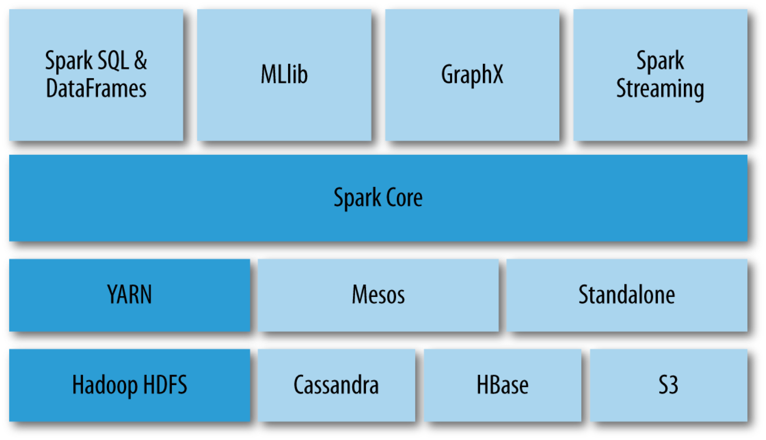
Spark Stack
Spark Libraries
Spark Core Module
* Resilient Distributed Datasets (RDDs)
Spark Job Schedulers
Data Storage Layer

Slide 8
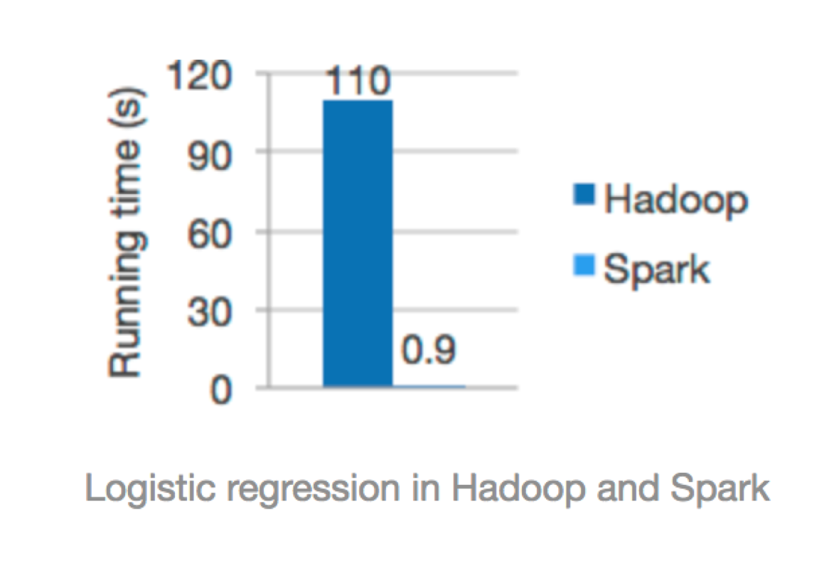
Spark vs. Hadoop
Spark is Faster
When the output of an operation needs to be fed into another operation, Spark passes the data directly without writing to persistent storage
Better for some iterative algorithms
e.g. machine learning algorithms
Spark runs programs up to 100x faster than Hadoop MapReduce in memory. [1]
[1] https://spark.apache.org/

Slide 9
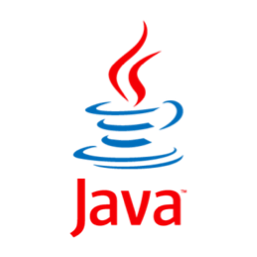







Other Advantages
Easy to use
Write applications quickly in Java, Scala, Python.
Runs Everywhere
Spark runs on Hadoop, standalone, or in the cloud
It can access diverse data sources including HDFS, Cassandra, HBase, and S3.
Generality
Combine SQL, streaming, and complex analytics

Slide 10
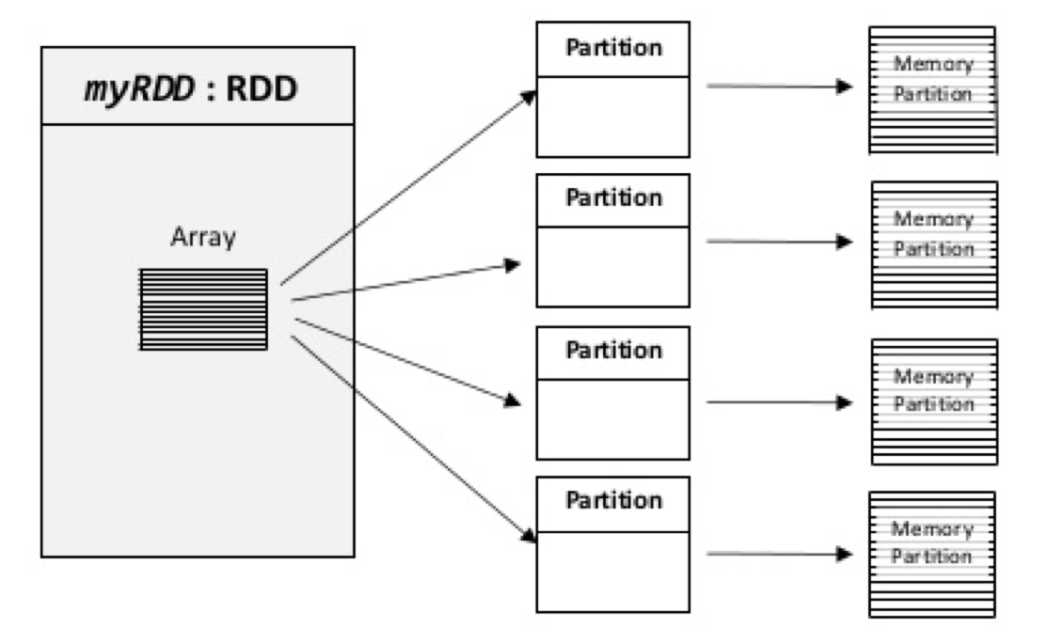
Resilient Distributed Datasets (RDDs)
An RDD is an immutable, in-memory collection of objects. Each RDD can be split into multiple partitions, which in turn are computed on different nodes of the cluster
RDDs are fault-tolerant, parallel data structures that let users
Explicitly persist intermediate results in memory
Control their partitioning to optimize data placement
Manipulate them using a rich set of operators
RDDs seem a lot like Scala collections
RDD[T] and List[T]

Slide 11
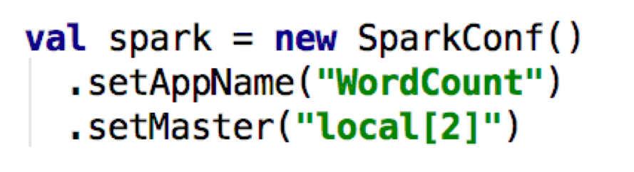
How to Create an RDD?
RDDs can be created in two ways:
Transforming from an existing RDD
E.g., a call on map on an RDD returns a new RDD
Start a new Spark job:
From a SparkContext (or SparkSession) object
The SparkContext object can be thought as your handle to the Spark cluster. It represents the connection between the Spark cluster and your running application
parallelize: convert a local Scala collection to an RDD
textFile: read a file from HDFS or local file system

Slide 12
Two Types of Operations on RDD
Transformations
Return new RDDs as results
They are lazy, their result RDD is not immediately computed
Actions
Compute a result based on an RDD, and returned
They are eager, their result is immediately computed.
Laziness / Eagerness is how we can limit network communication using the programming model

Slide 13
Common Transformations
map
map[T](f: A=>B): RDD[T]
Apply function to each element in the RDD and return an RDD of the result.
flatmap
flatmap[T](f: A=>B): RDD[T]
Apply function to each element in the RDD and return an RDD of the result, but output is flattened.
filter
filter[T](pred: A=>Boolean): RDD[T]
Apply a predicate function, pred, to each element in the RDD and return an RDD of elements that passed the condition.
distinct
distinct():RDD[T]
Return an RDD with duplicates removed

Slide 14
Common "Transformations” on RDD
map(func)
mapValues(func)
filter(func)
flatMap(func)
reduceByKey(func, [numTasks])
groupByKey([numTasks])
sortByKey([asc], [numTasks])
distinct([numTasks])
mapPartitions(func)

Slide 15
Common Actions
collect
collect: Array[T]
Return all elements from RDD.
count
count(): Long
Return the number of elements in the RDD.
take
take(num: Int): Array[T]
Return the first num elements of the RDD.
reduce
reduce(op: (A, A) => A): A
Combine the elements in the RDD together using op function and return result.
foreach
foreach(f: A => Unit): Unit
Apply function to each element in the RDD, and return Unit.

Slide 16
Common ”Actions” on RDD
getNumPartitions()
foreachPartition(func)
collect()
take(n)
count(), sum(), max(), min(), mean()
reduce(func)
aggregate(zeroVal, seqOp, combOp)
countByKey()

Slide 17

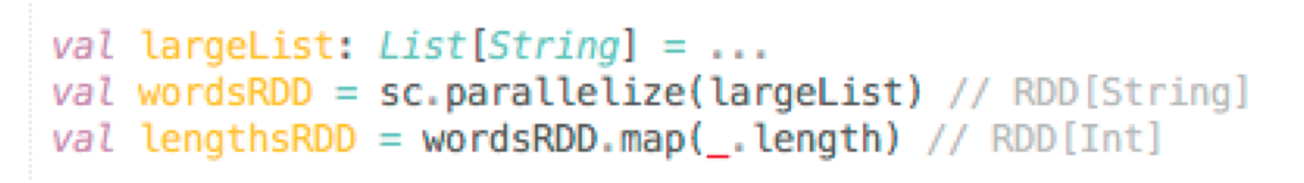
Example
Consider the following example:
sc -> SparkContext
?
What has happened on the cluster at this point?

Slide 18
Example
Consider the following example:
What has happened on the cluster at this point?
Nothing. Execution of map (a transformation) is deferred.

Slide 19

Example
Consider the following example:
What has happened on the cluster at this point?
Nothing. Execution of map (a transformation) is deferred.
?
How to ensure this computation is done on the cluster?

Slide 20
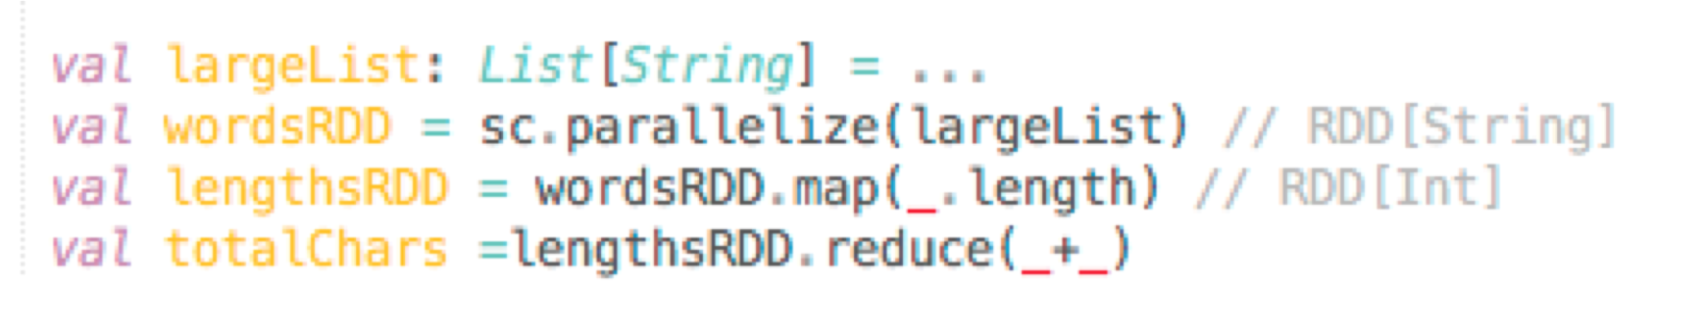

Example
Consider the following example:
add an action
Spark starts the execution when an action is called.
Return the total number of characters in the entire RDD of strings

Slide 21


Benefits of Laziness
Another example:
The execution of filter is deferred until the take action happens
Spark leverages this by analyzing and optimizing the chain of operations before executing it.
Spark will not compute intermediate RDDs. Instead, as soon as 10 elements of the filtered RDD have been computed, logsWithErrors is done.
Spark saves time and space to compute elements of the unused result of filter.

Slide 22


Why Spark is Good for Data Sci
In-memory computation
RDD operations
Transformations: Lazy, deferred
Actions: Eager, kick off staged transformations
Why Spark is good for data science?
Machine learning algorithms

Slide 23
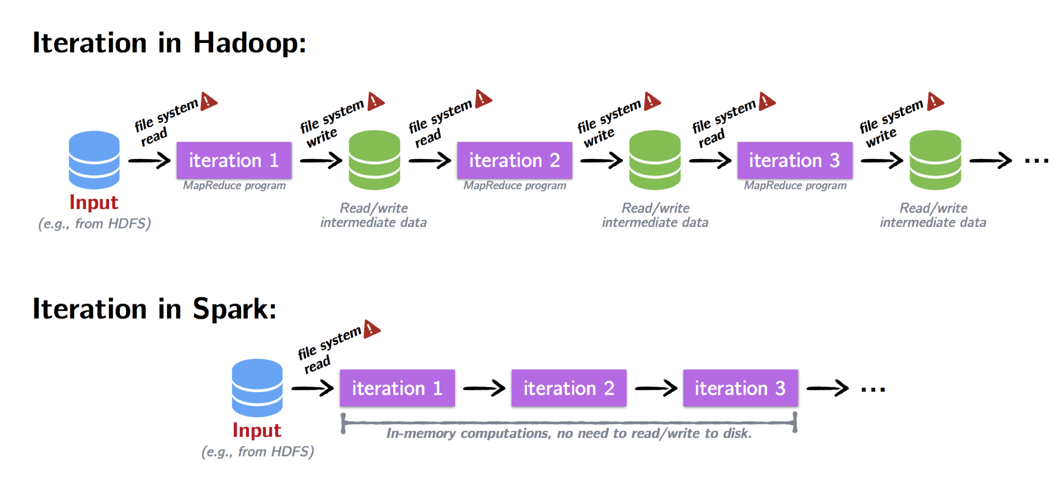
Iteration
Most data science problems involve iteration

Slide 24
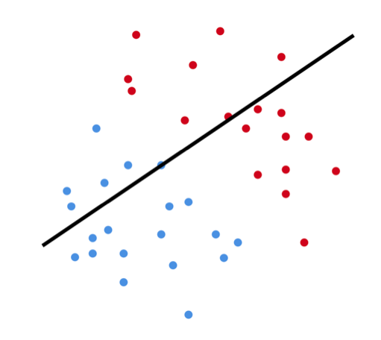
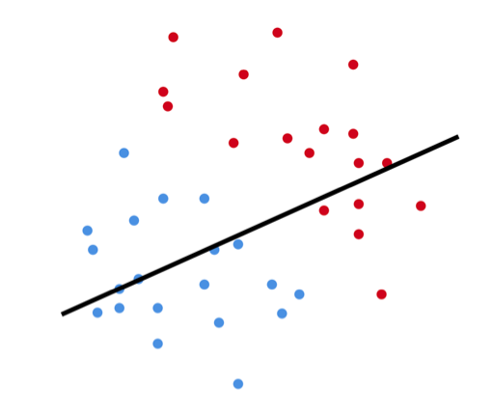
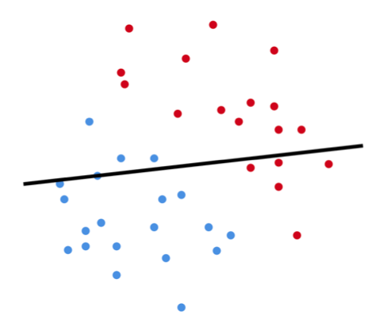



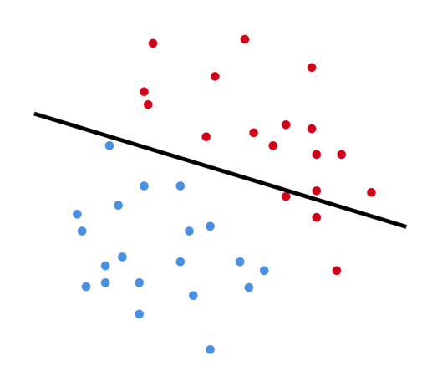
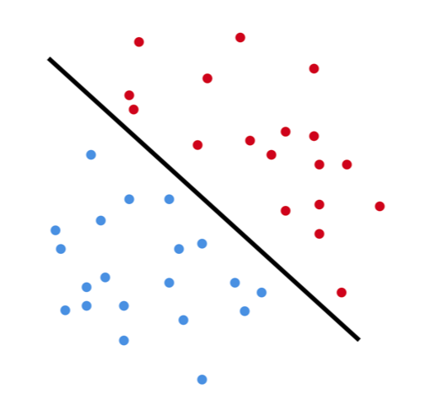
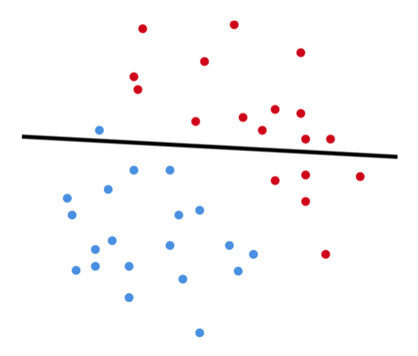



Logistic regression is an iterative algorithm typically used for classification. Like most classification algorithms, it updates weights iteratively base on the training data.
Iteration Example: Logistic Regression

Slide 25
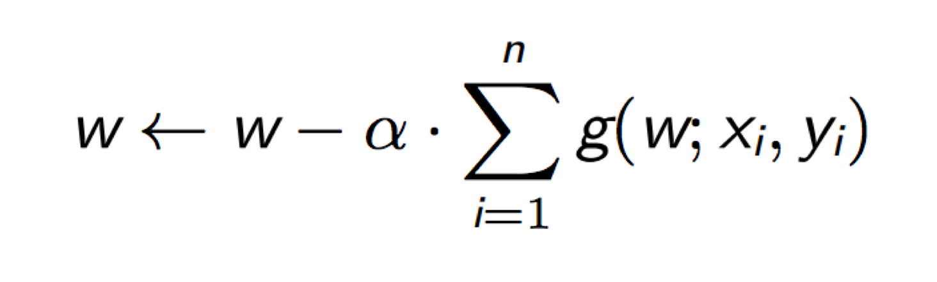
Logistic regression is an iterative algorithm typically used for classification. Like most classification algorithms, it updates weights iteratively base on the training data.
Iteration Example: Logistic Regression

Slide 26
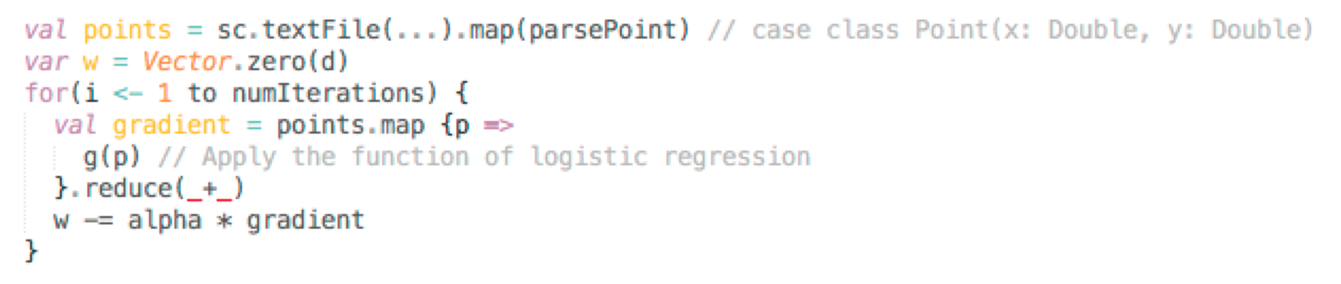
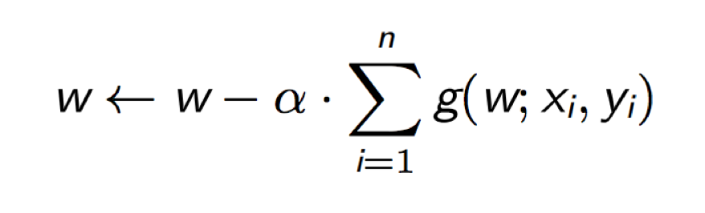
Iteration Example: Logistic Regression
Logistic regression is an iterative algorithm typically used for classification. Like most classification algorithms, it updates weights iteratively base on the training data.
What is the weakness for this code?

Slide 27


Iteration Example: Logistic Regression
Logistic regression is an iterative algorithm typically used for classification. Like most classification algorithms, it updates weights iteratively base on the training data.
Spark starts the execution when the action reduce is applied.

Slide 28


Iteration Example: Logistic Regression
Logistic regression is an iterative algorithm typically used for classification. Like most classification algorithms, it updates weights iteratively base on the training data.
points is being re-evaluated upon every iteration!
Unnecessary!

Slide 29
Caching and Persistence
By default, RDDs are recomputed each time you run an action on them. This can be expensive (time-consuming) if you need to use a dataset more than once.

Slide 30
Caching and Persistence
By default, RDDs are recomputed each time you run an action on them. This can be expensive (time-consuming) if you need to use a dataset more than once.
Spark allows you to control what is cached in memory. use persist() or cache()
cache() : using the default storage level persist(): can pass the storage level as a parameter,
e.g., “MEMORY_ONLY”, “MEMORY_AND_DISK”

Slide 31
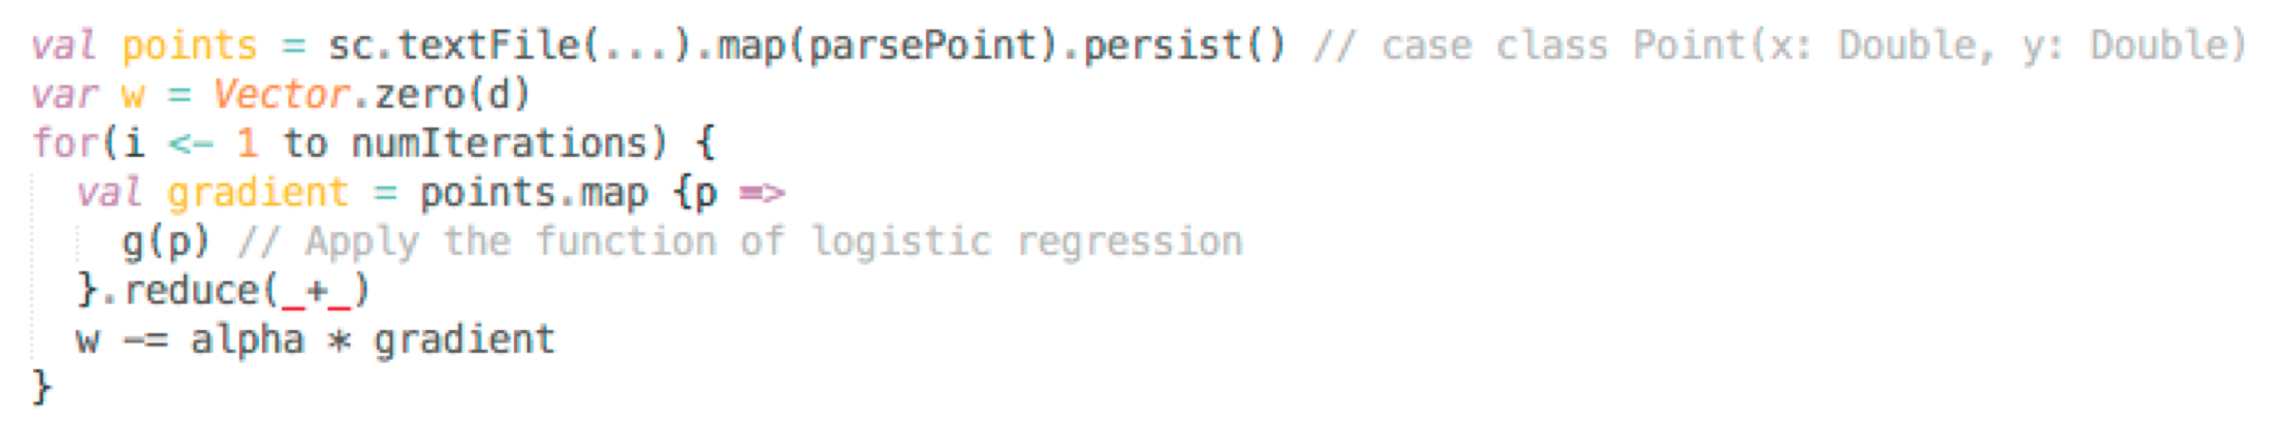

Iteration Example: Logistic Regression
Logistic regression is an iterative algorithm typically used for classification. Like most classification algorithms, it updates weights iteratively base on the training data.
points is evaluated once and is cached in memory.
It can be re-used on each iteration.

Slide 32
Why Spark is Good for Data Sci
The lazy semantics of RDD transformation operations help improve the performance.
One of the most common performance bottlenecks for newcomers to Spark arises from unknowingly re-evaluating several transformations when caching could be used.

Slide 33
Why Use Spark Operations?
Technically, one can implement in Python most of operations by map/flatMap by embedding the statement into the input func in Python
Spark is implemented by Java, runs in jvm, so it is faster than Python
Spark can analyze and optimize the computing process

Slide 34
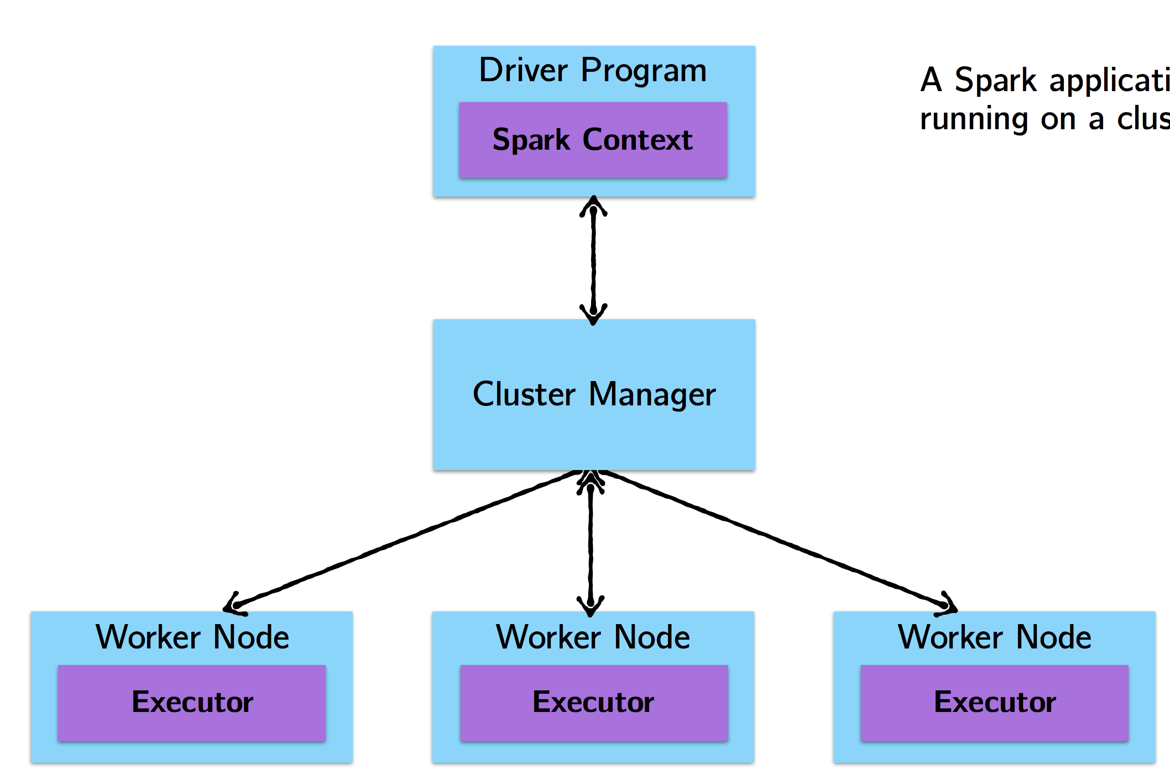

How Spark jobs are Executed?
Steps of executing a Spark program:
The driver program runs the Spark application, which creates a SparkContext.
The SparkContext connects to a cluster manager to allocate resources
Spark acquires executors on nodes in the cluster, which run computations for your application.
Driver program sends your application code to executors to execute.
12

Slide 35
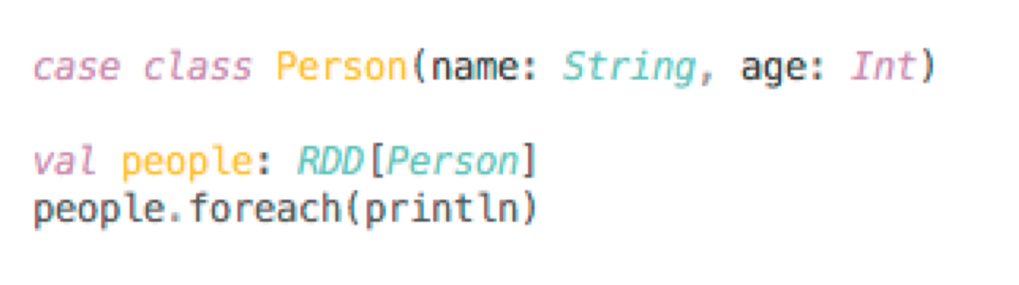
Cluster Topology
A simple example with println
What happens?

Slide 36
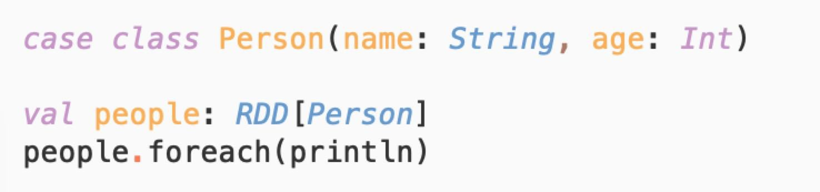
Cluster Topology
A simple example with println
On the driver: Nothing.
Why? Recall that foreach is an action, with returns type Unit. Therefore, it will be eagerly executed on the executors. Thus, any calls to println are happening on the worker nodes and are not visible in the drive node.
14

Slide 37
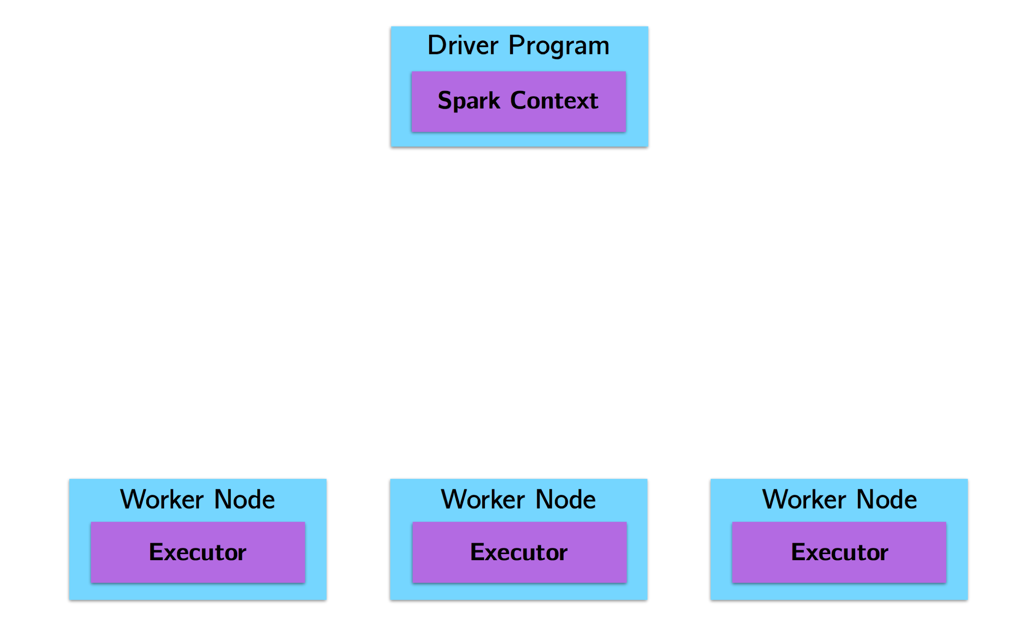
How Spark jobs are Executed
In the context of a Spark program

Slide 38
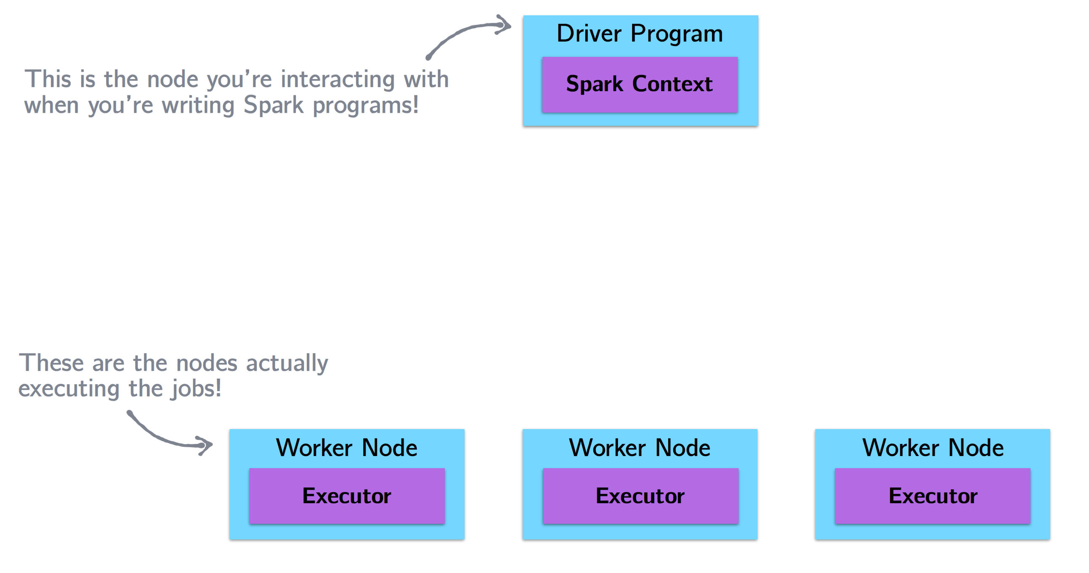
How Spark jobs are Executed

Slide 39
How Spark jobs are Executed
How do they communicate?

Slide 40
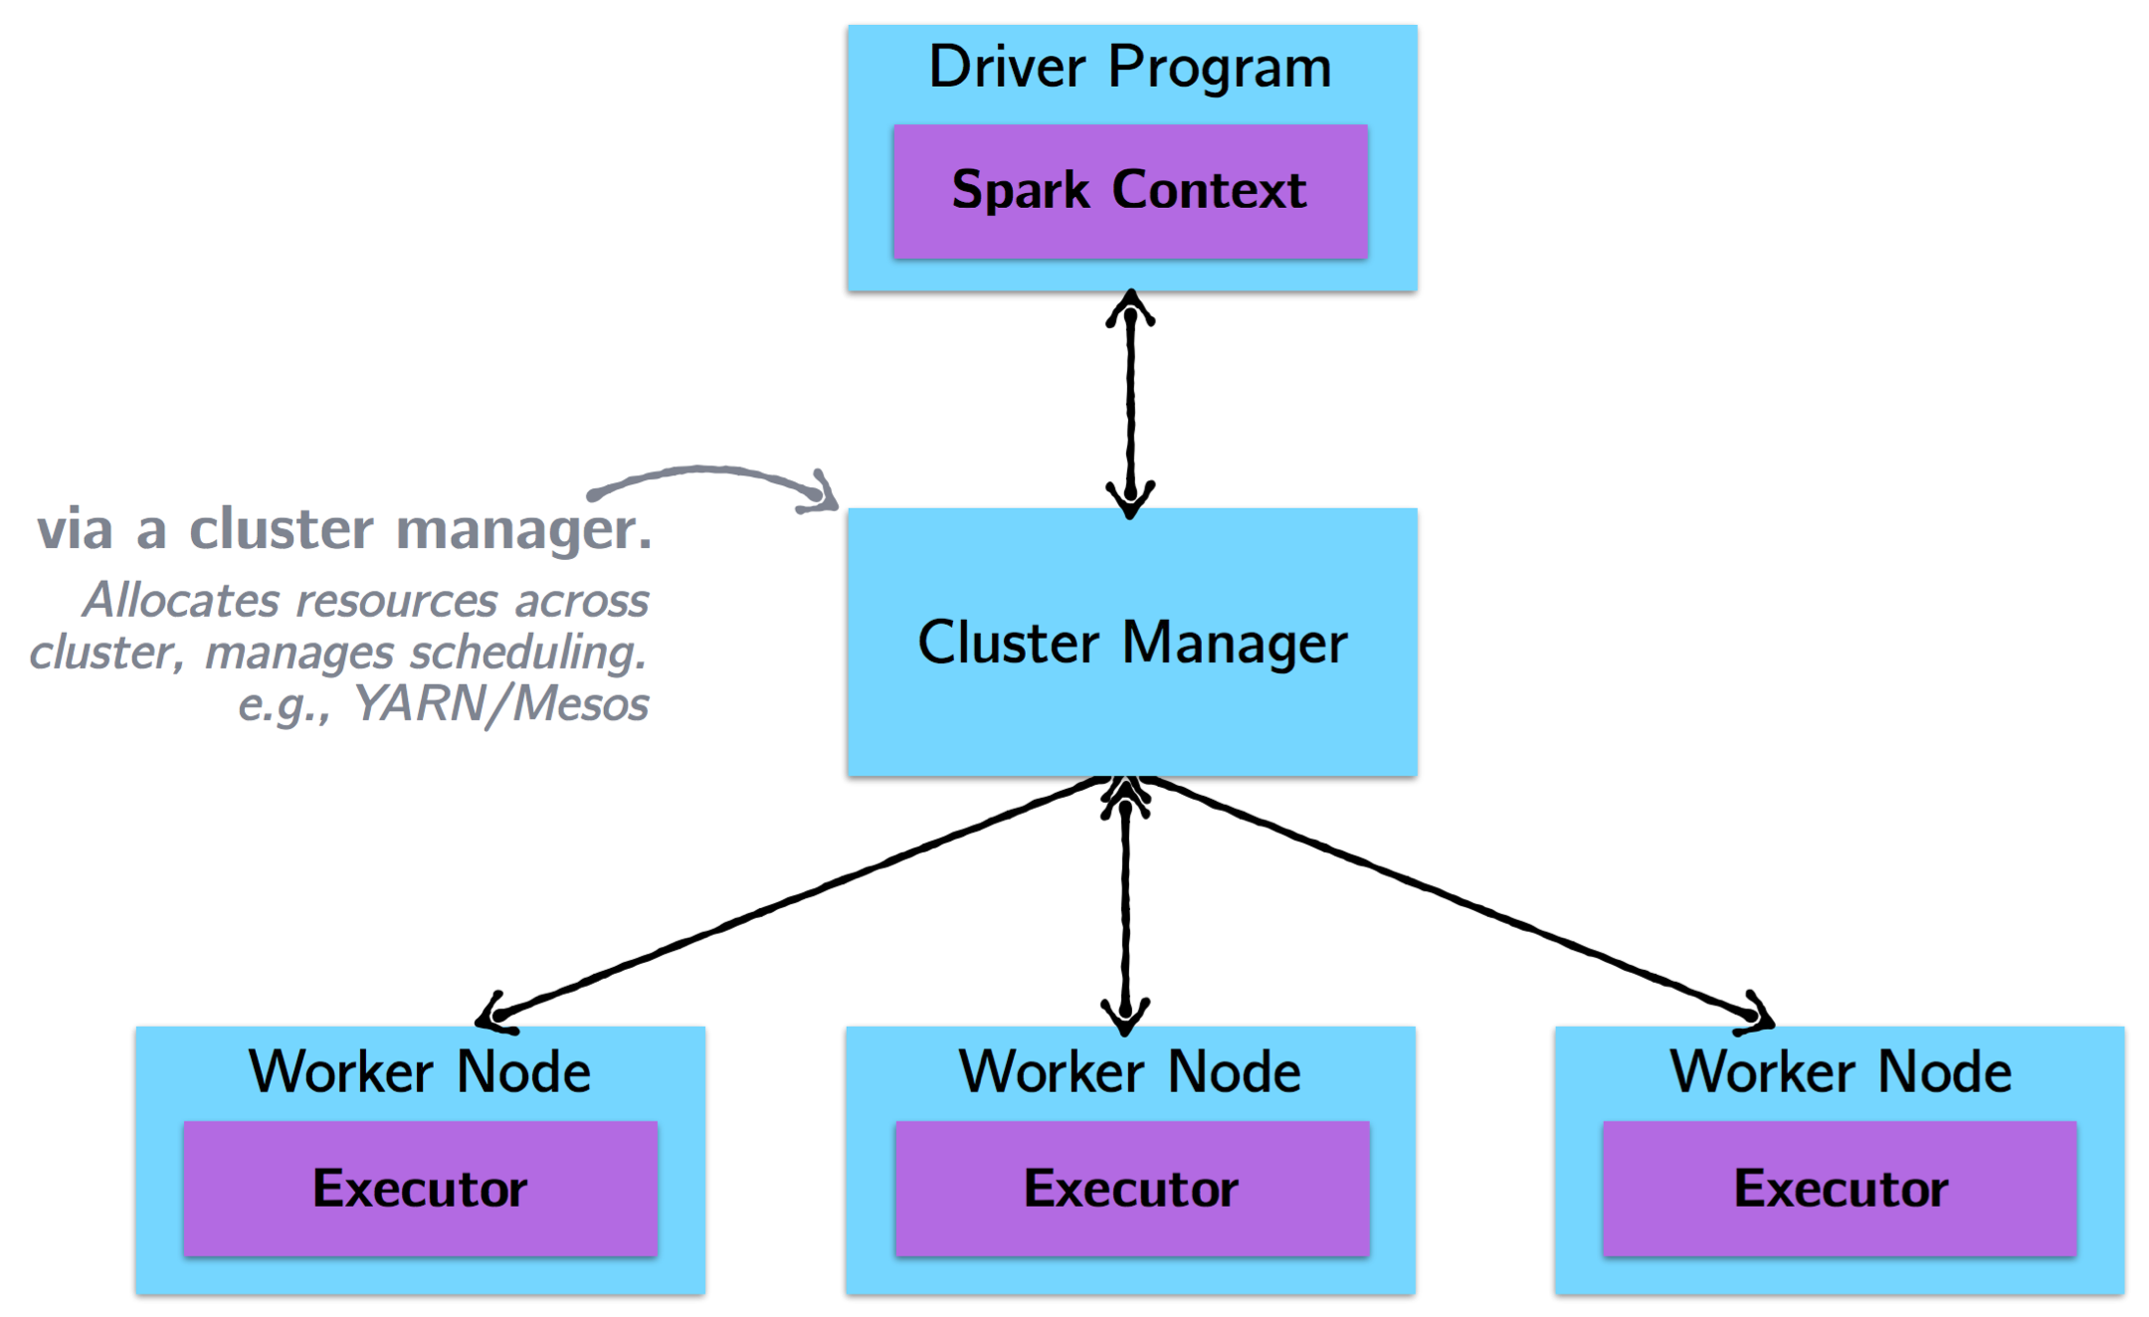


How Spark jobs are Executed

Slide 41
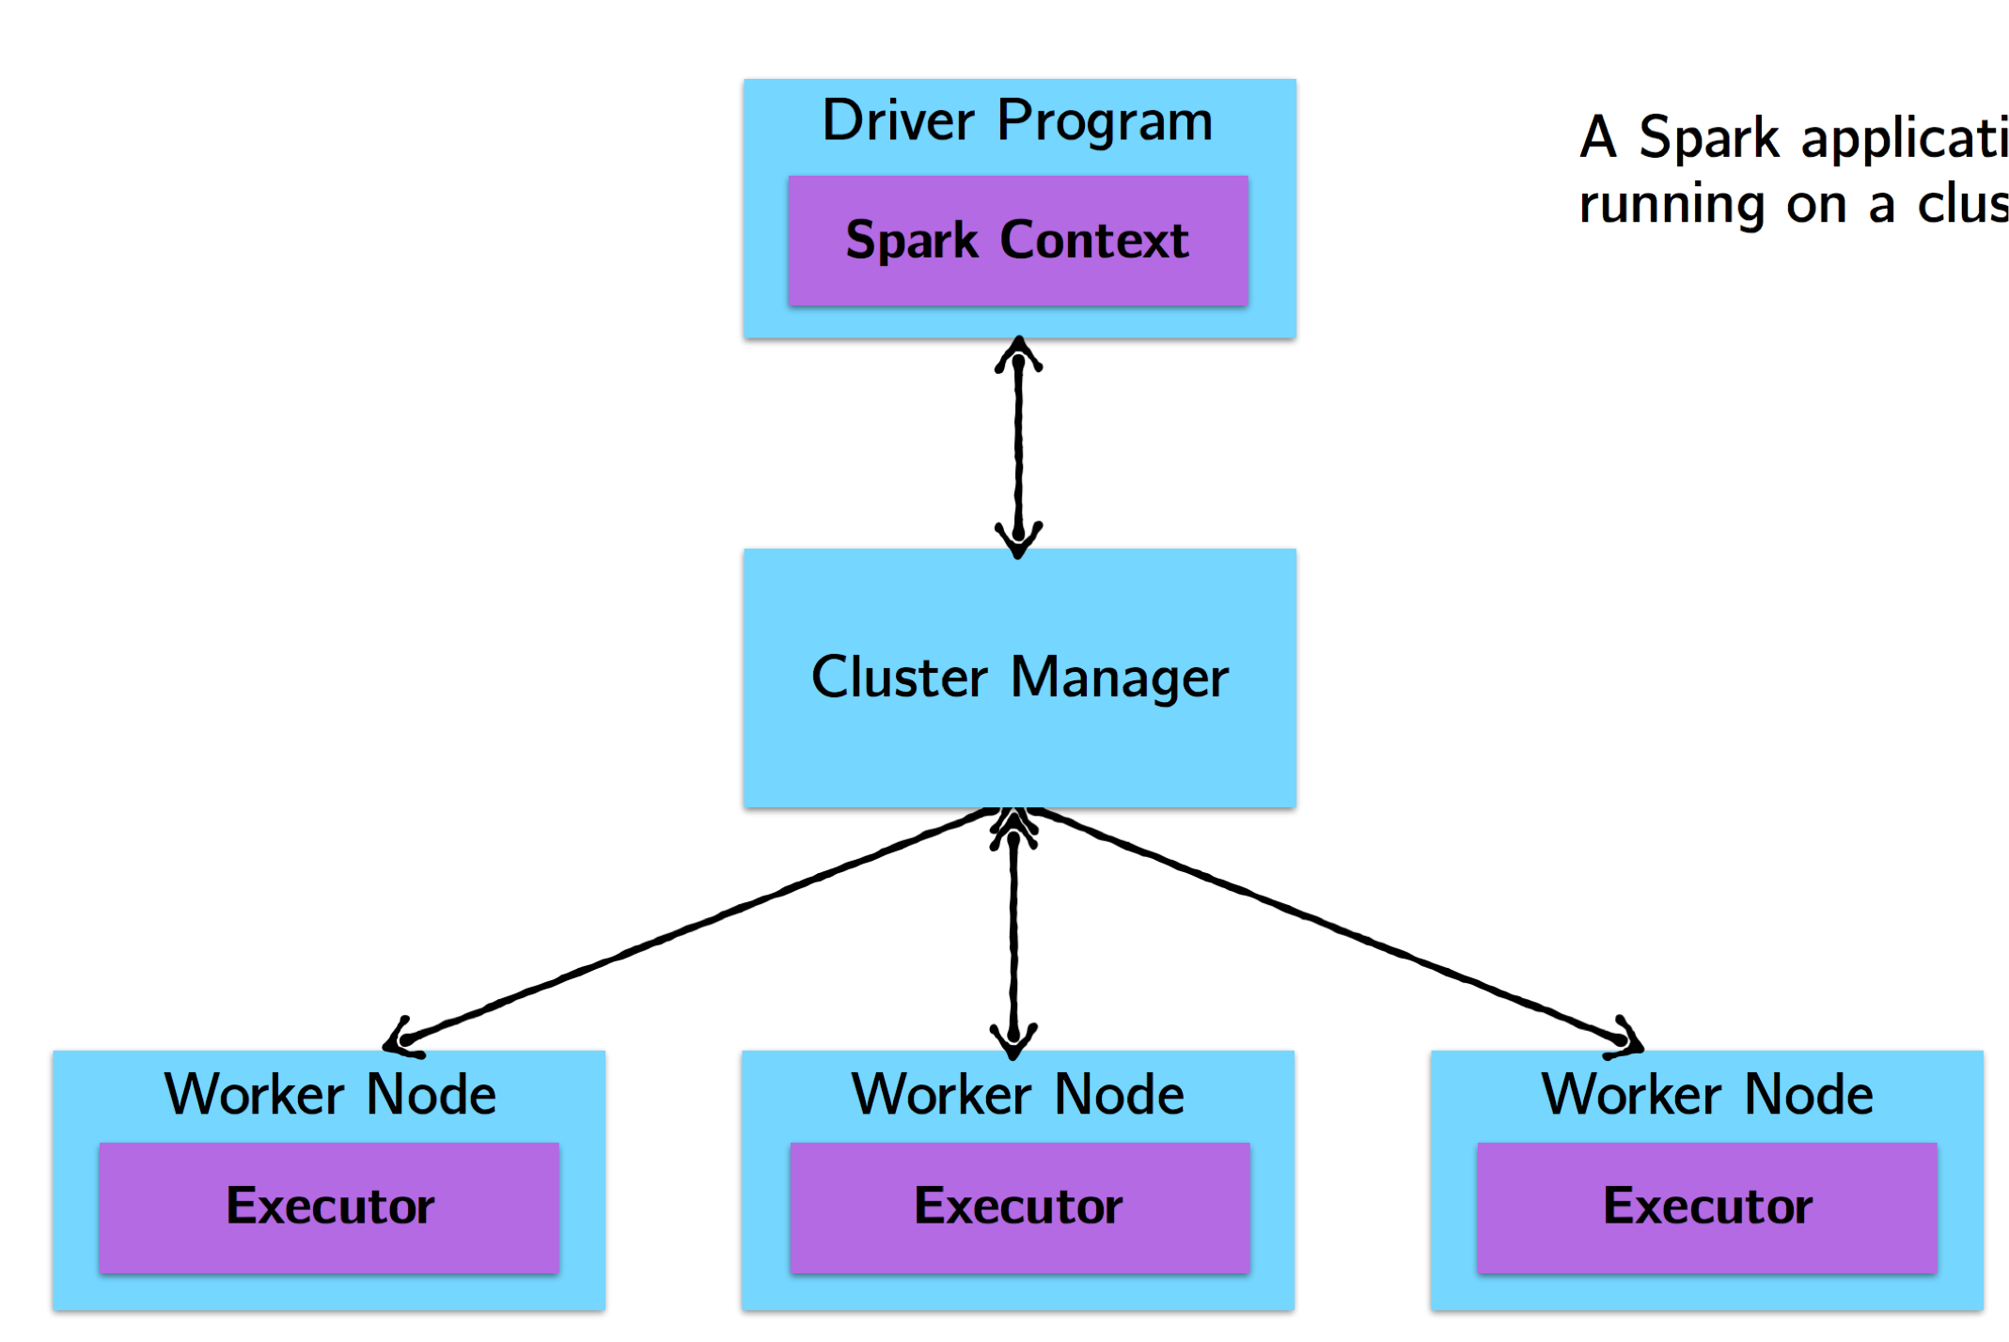
How Spark jobs are Executed
Driver Program:
At a high level, every Spark application consists of a driver program that launches various parallel operations on the cluster.
The driver program contains your application’s main function and defines distributed datasets on the cluster, then applies operations to them.
Spark Context:
Driver programs access Spark through a SparkContext object

Slide 42
How Spark jobs are Executed
Worker Node:
The node which run applications in a cluster
Executor:
Executors are worker nodes' processes in charge of running individual task in a given Spark job, including returning computed results to driver and providing in-memory storage for cached RDDs.

Slide 43
How Spark jobs are Executed
Steps of executing a Spark program:
1, The driver program runs the Spark application, which creates a SparkContext. 2, The SparkContext connects to a cluster manager to allocate resources.
3, Spark acquires executors on nodes in the cluster, which run computations for your application.
4, Driver program send your application code to executors to execute.

Slide 44
Cluster Toplogy
A simple example with println
On the driver: Nothing.
Why? Recall that foreach is an action, with return type Unit. Therefore, it is eagerly executed on the executors, not the driver. Thus, any calls to println are happening on the worker nodes and are not visible in the drive node.

Slide 45
Cluster Topology
Another simple example with take
val first10 = people.take(10)
Where will first10 end up?

Slide 46
Cluster Topology
Another simple example with take
val first10 = people.take(10)
Where will first10 end up? The driver program.
In general, executing an action involves communication between worker nodes and the node running the driver program.

Slide 47
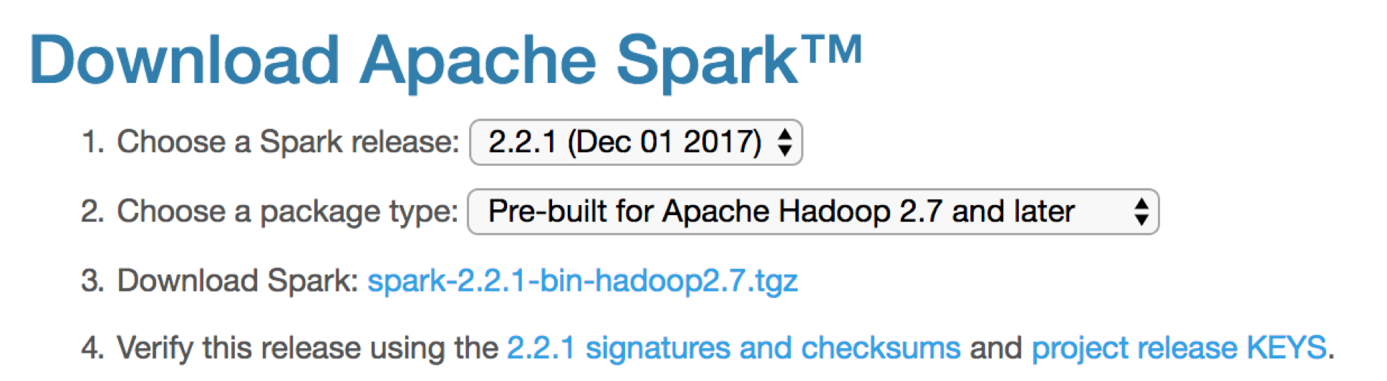
Install Spark
Download Spark from official website:
– http://spark.apache.org/downloads.html
Note: on Vocareum: spark-submit version was 2.4.4. in 2021 Spring,
and it may be subject to upgrade to the latest 3.1.2. in 2021 Fall.

Slide 48
Run Python/Spark on command line
Make sure keep the same python version for driver & worker
Edit ./conf/spark-env.sh (copy from ./conf/spark-env.sh.template)
Add environment variables
On the command line, you can do:
bin/spark-submit ./word_count.py
Try this on a terminal window
On your local machine
On Vocareum, in the terminal window, type
/home/local/spark/latest/bin/spark-submit ./word_count.py
19

Slide 49
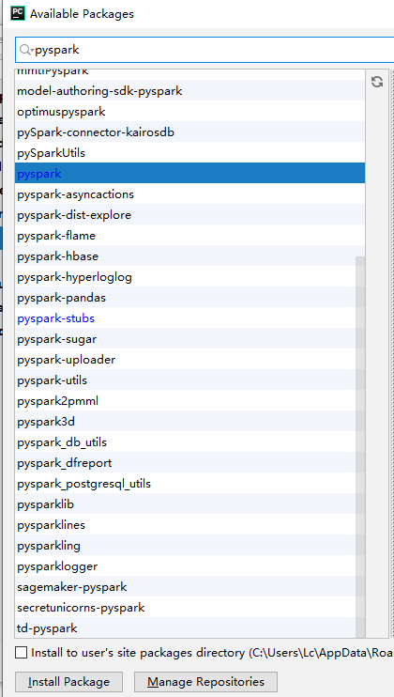
Pyspark
Pycharm is recommended
You can use pip install pyspark
Or config in PyCharm:
- click[Run] -> [Edit Configurations] -> Add[Environment variables]
Install pyspark package
Make sure keep the same python
version for driver and worker

Slide 50
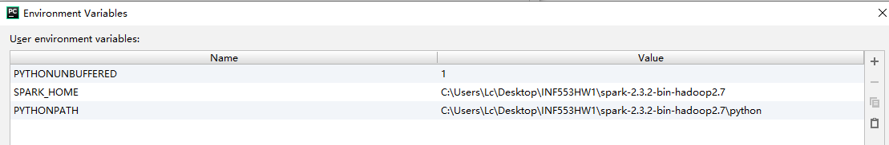
Set environment variables
SPARK_HOME
The root address of your downloaded spark folder
PYTHONPATH
The address of “python” folder under your SPARK_HOME address

Slide 51
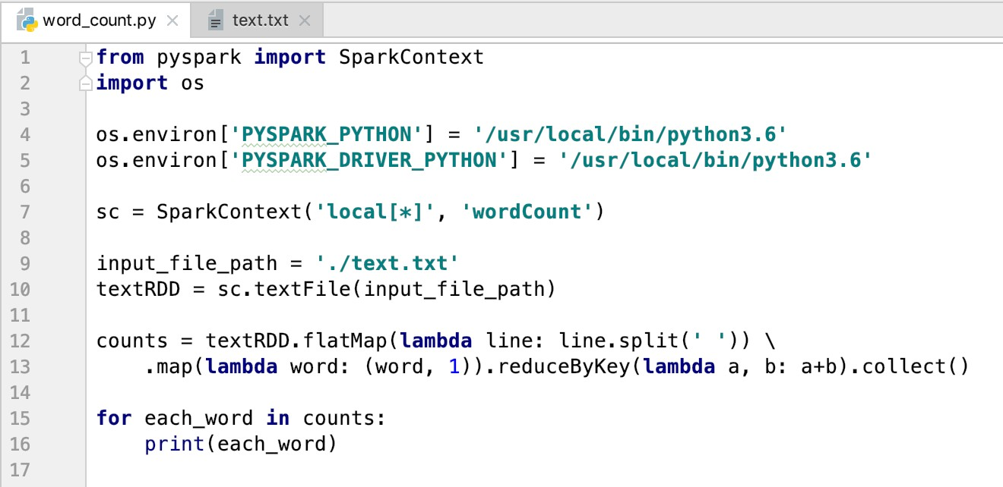
Sample Code: word_count.py

Slide 52
Install Scala
IntelliJ IDEA, the compiler:
https://www.jetbrains.com/idea/#chooseYourEdition
Install Scala plugin in the compiler
Open Preference -> Choose [Plugins] -> Click [Install JetBrains plugin] (at bottom) -> Search Scala and Install

Slide 53
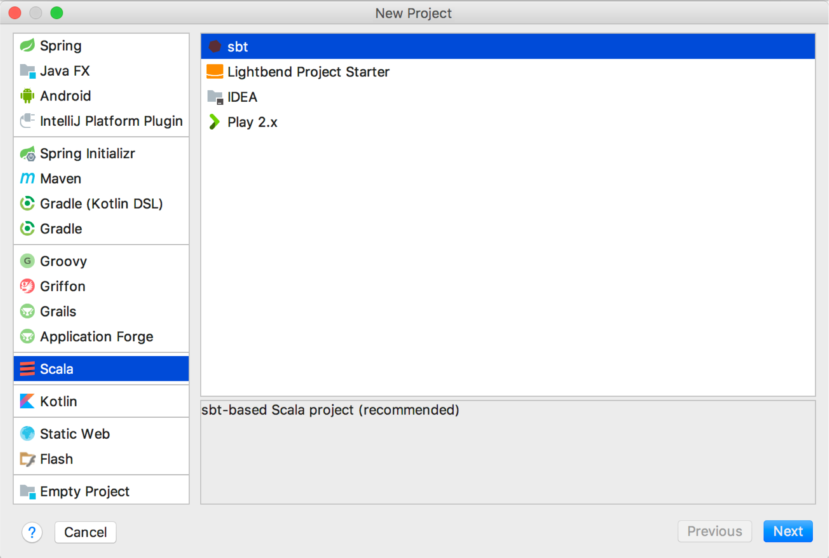
Create an SBT project

Slide 54
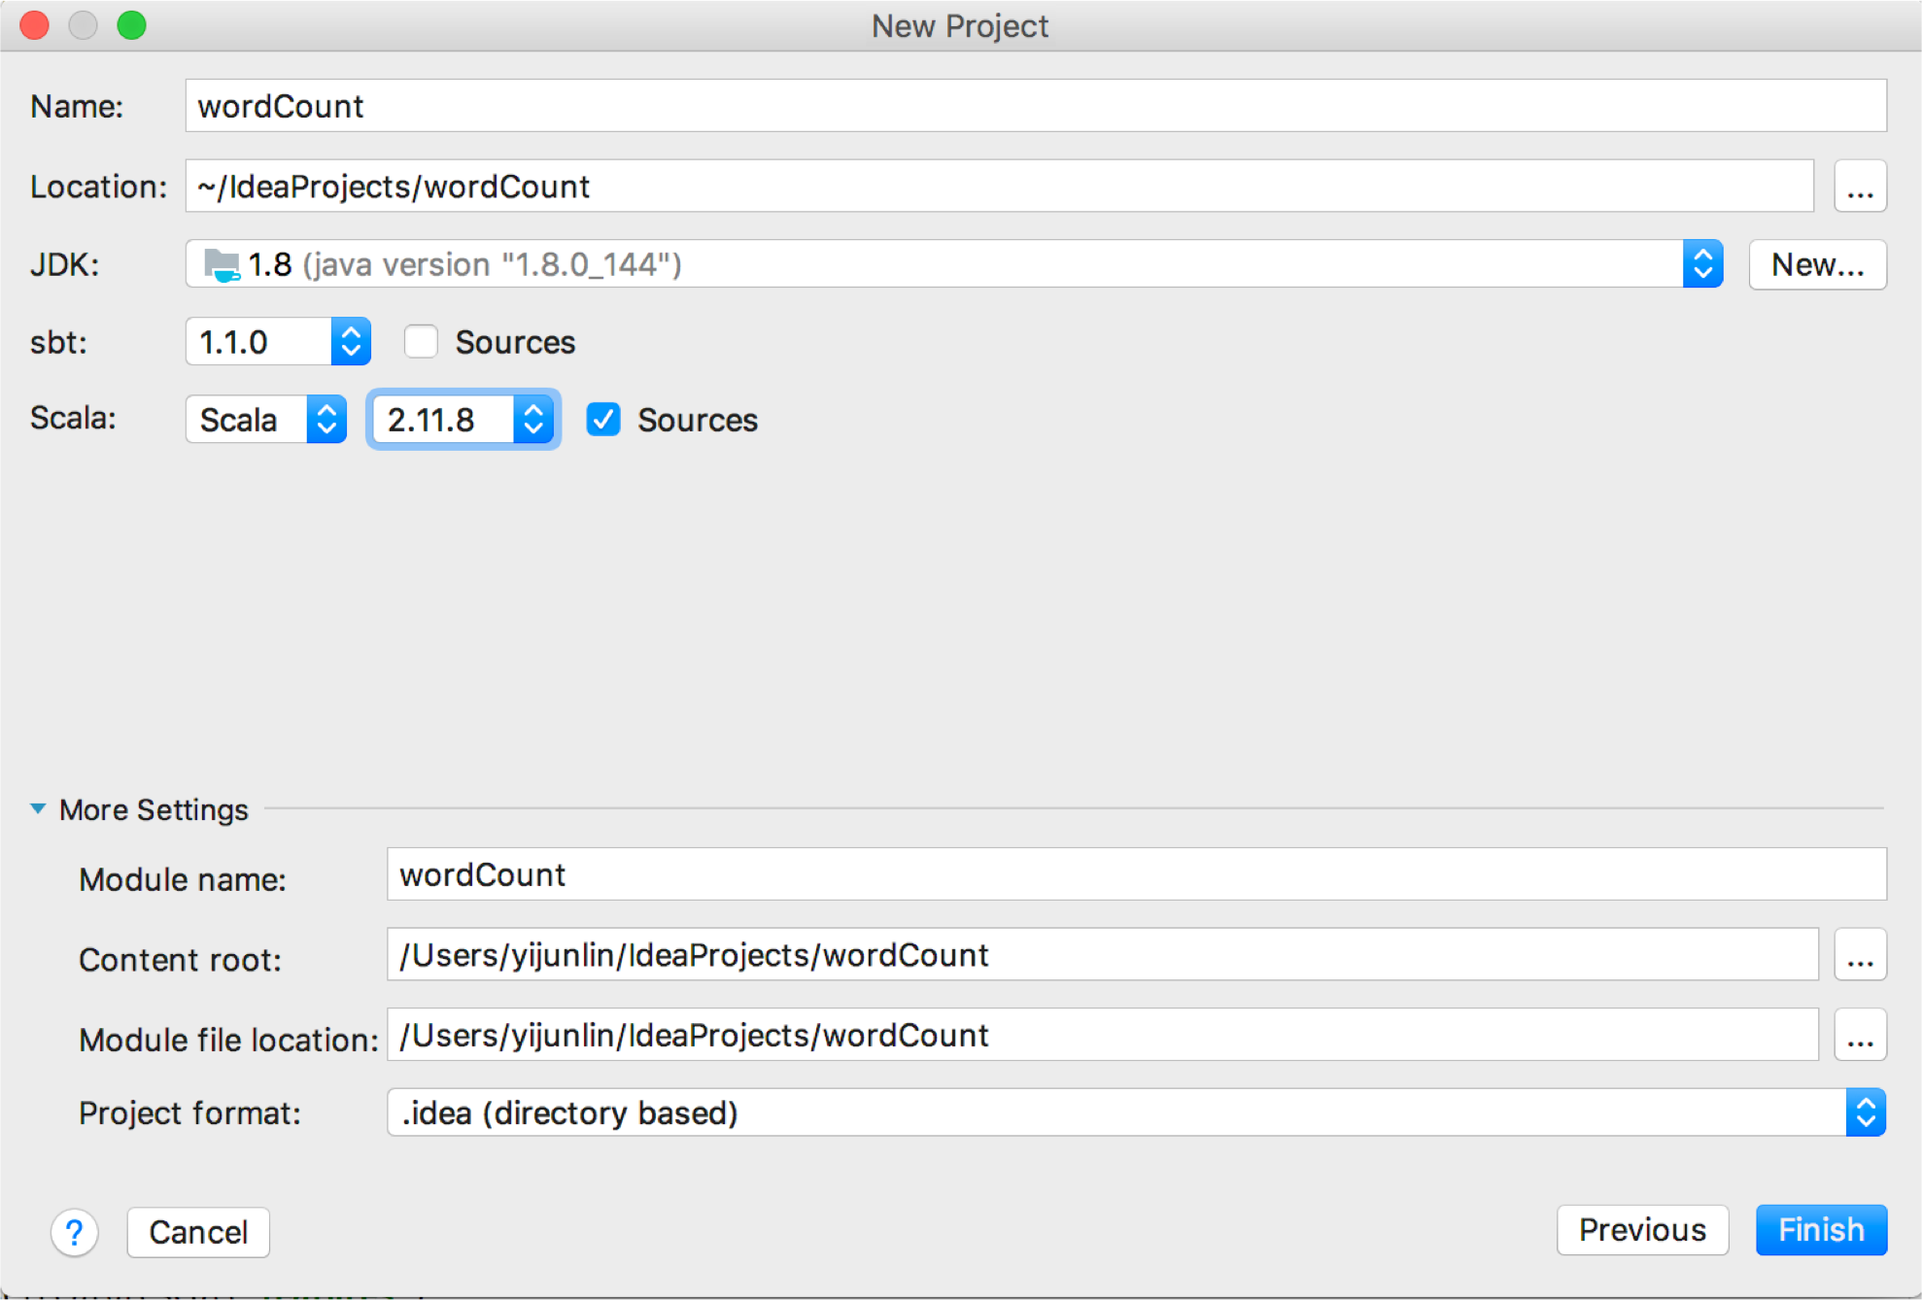
Create an SBT project

Slide 55
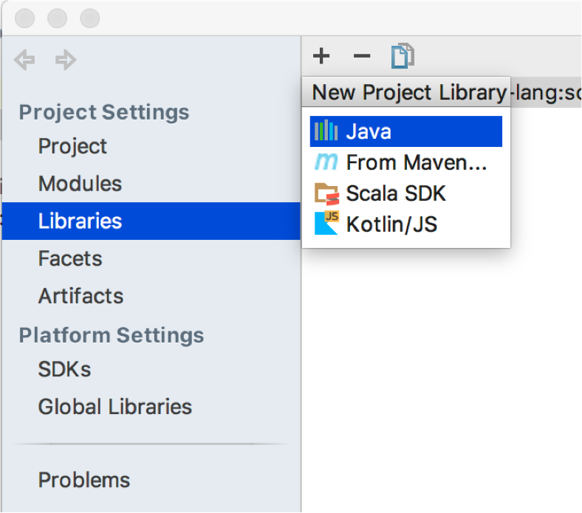
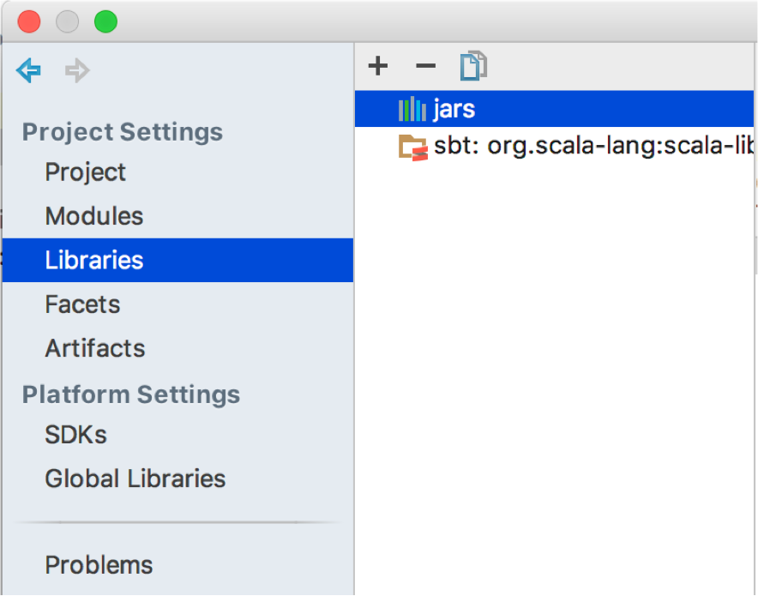
Add Spark Environment
You can add Spark either in External Libraries or through build.sbt
External Libraries:
Click [File] -> [Project Structure] -> [Libraries] -> [+] Java library -> Add the jar package/.jar file from the Spark you download

Slide 56
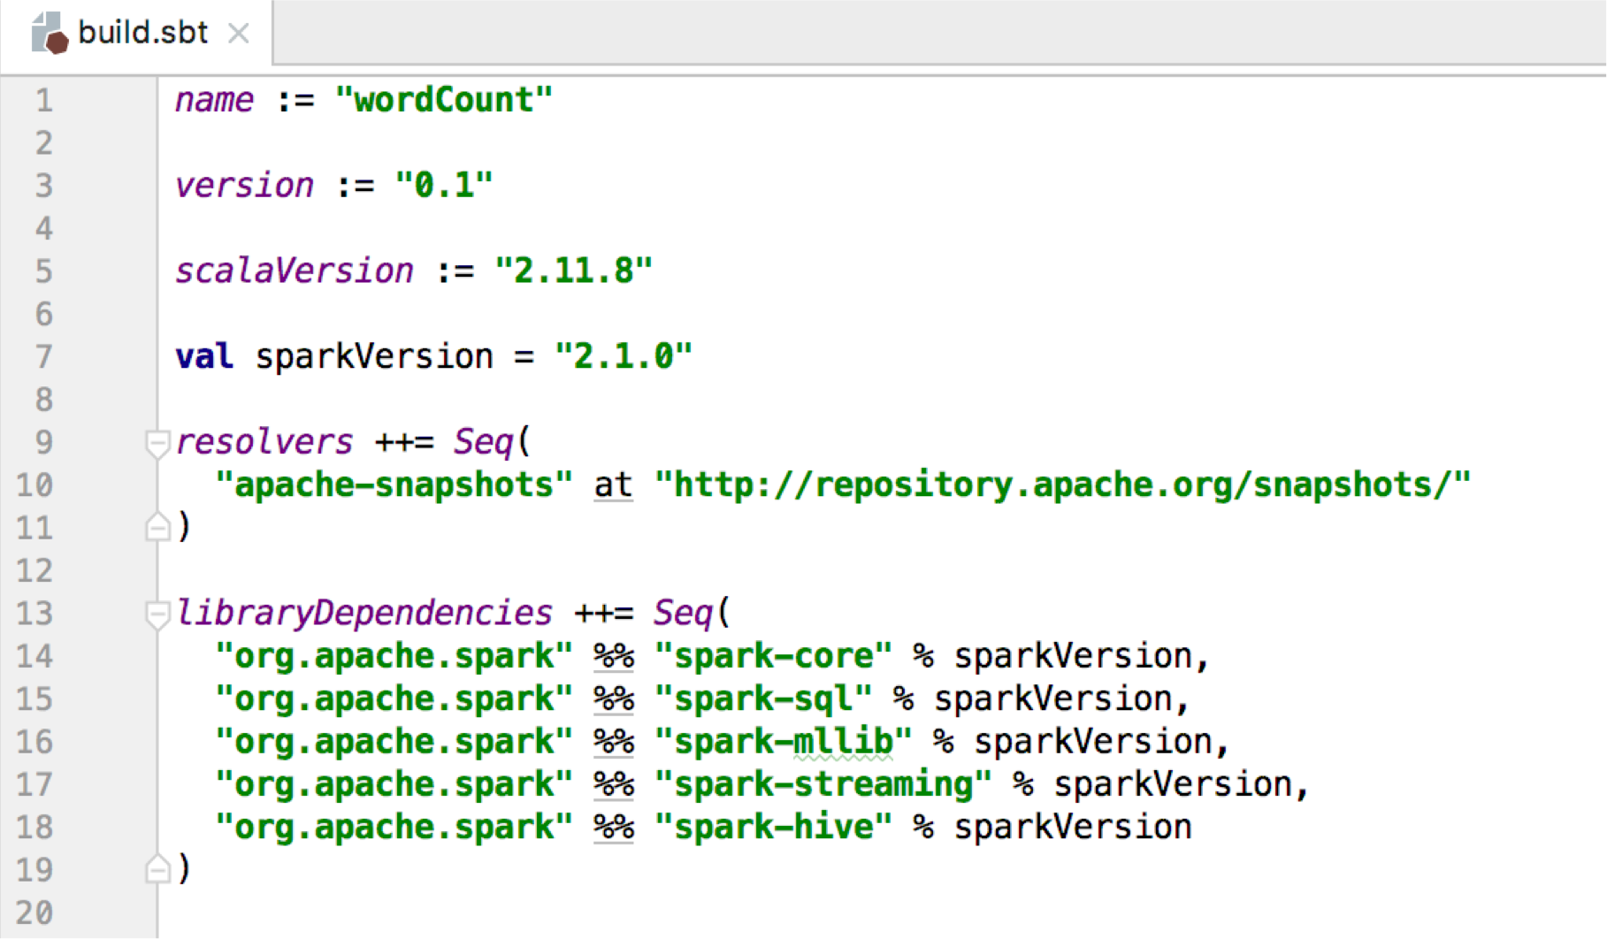
Add Spark Environment
You can add Spark either in External Libraries or through build.sbt
– build.sbt

Slide 57
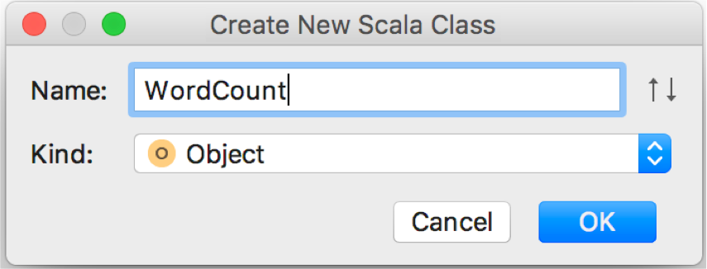
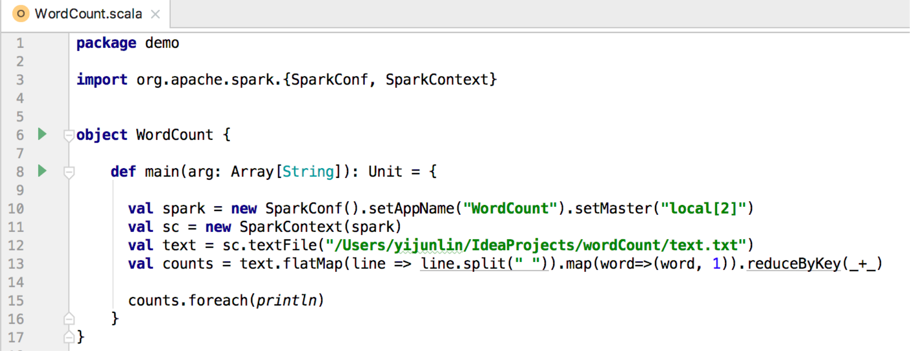
Write Scala Code
Create new Scala object
local[2]: start SparkContext with 2 cores local[*], start SparkContext with all available cores

Slide 58
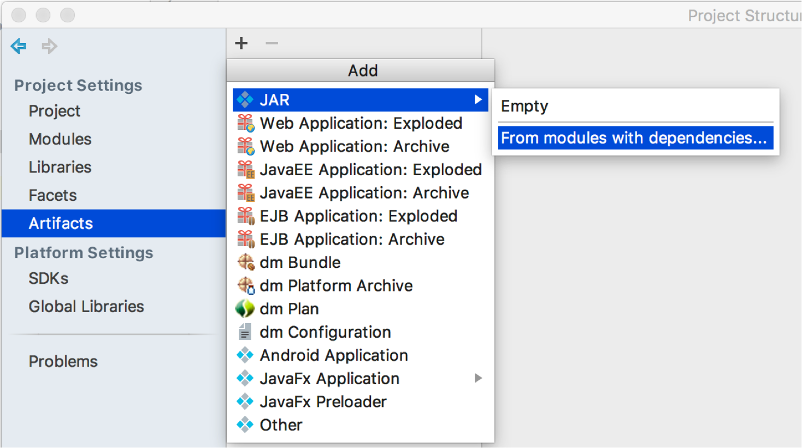
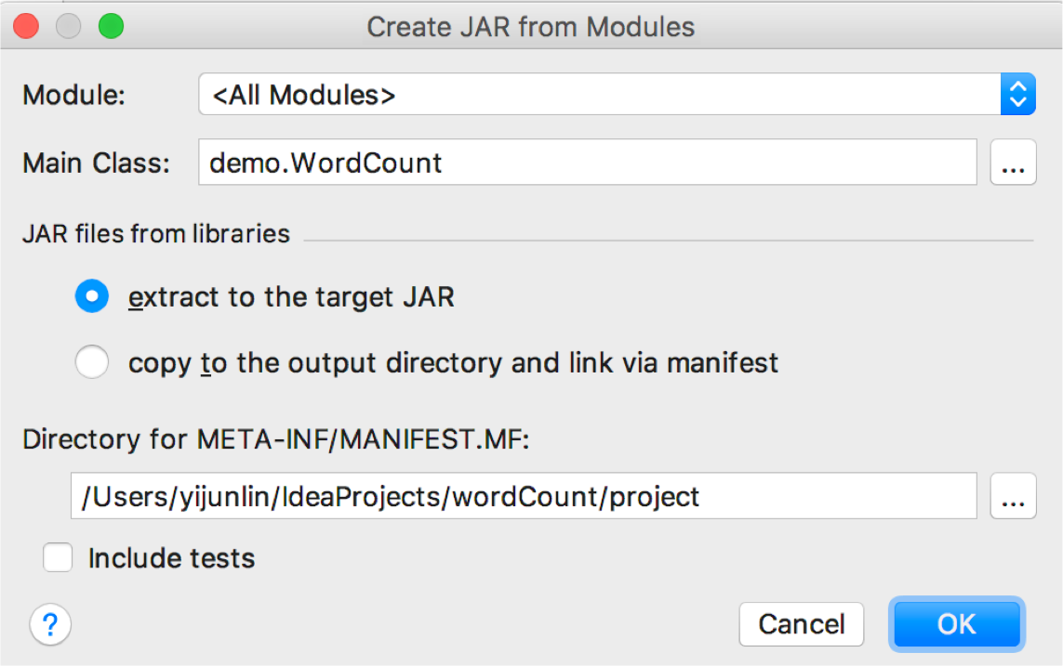

Build jar
Click [File] -> [Project Structure] -> [Artifacts] -> [+] JAR -> [From modules with dependencies] -> Put the Main Class of your code -> [OK]

Slide 59
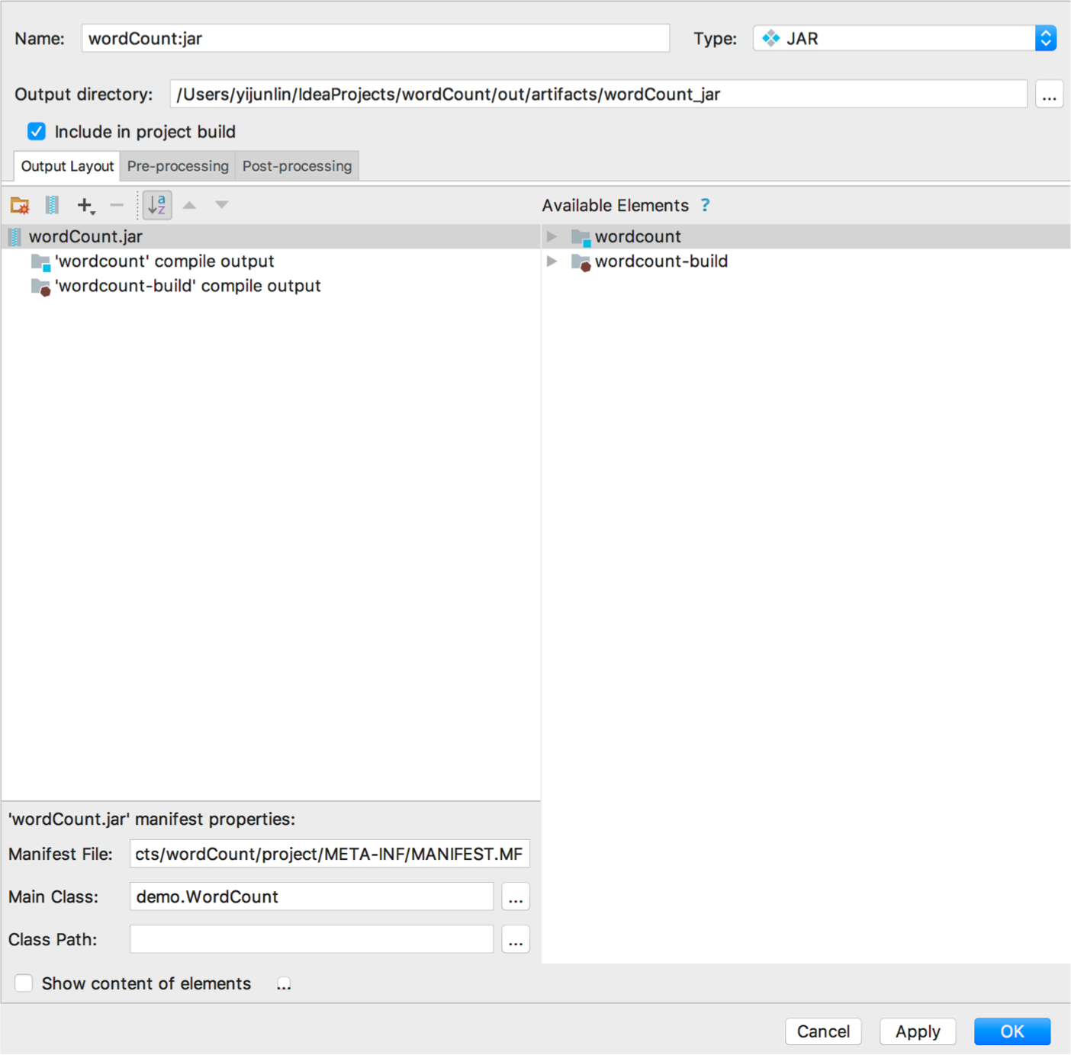
Build jar
You need to delete all the spark libraries or other unrelated libraries that you would not use in your program; Click [OK]
Click [Build] -> [Build Artifects] -> [Build] -> produce the package out, the jar file is in it!

Slide 60
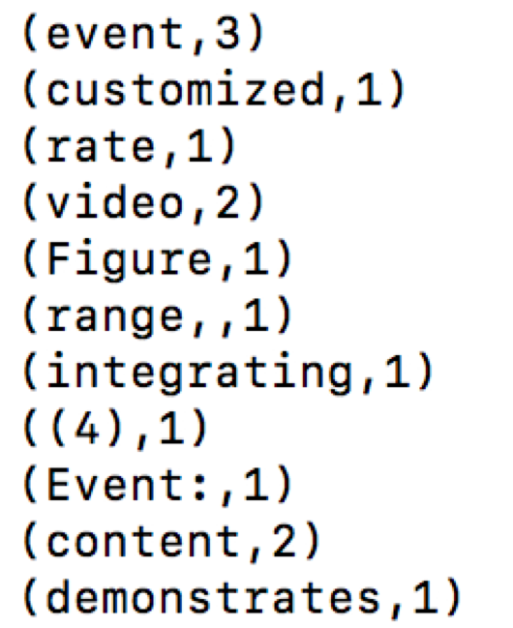
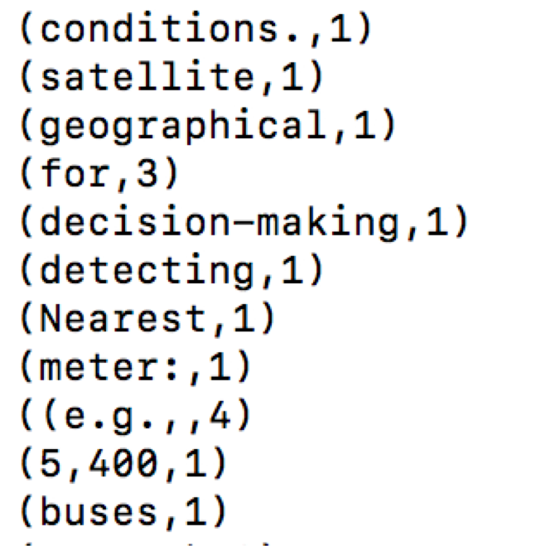
Run jar on Spark - command line
or: % bin/spark-submit –class wordcount ./****/wordCount.jar
Show the Result:

Slide 61
If you want to learn more…
Official documentation
http://spark.apache.org/docs/latest/
Online course
Coursera: Big Data Analysis with Scala and Spark
Books
Learning Spark, O’ Reilly
Advanced Analytics with Spark: Patterns for Learning from Data at Scale, O’ Reilly
Machine Learning with Spark, Packt
Please read the complete list of operations:
http://spark.apache.org/docs/latest/api/python/pyspark.html
Please read Spark Programming Guide:
https://spark.apache.org/docs/latest/

Slide 62
Attachments

Slide 63
Common Actions
getNumPartitions()
foreachPartition(func)
collect()
take(n)
count(), sum(), max(), min(), mean()
reduce(func)
aggregate(zeroVal, seqOp, combOp)
countByKey()

Slide 64
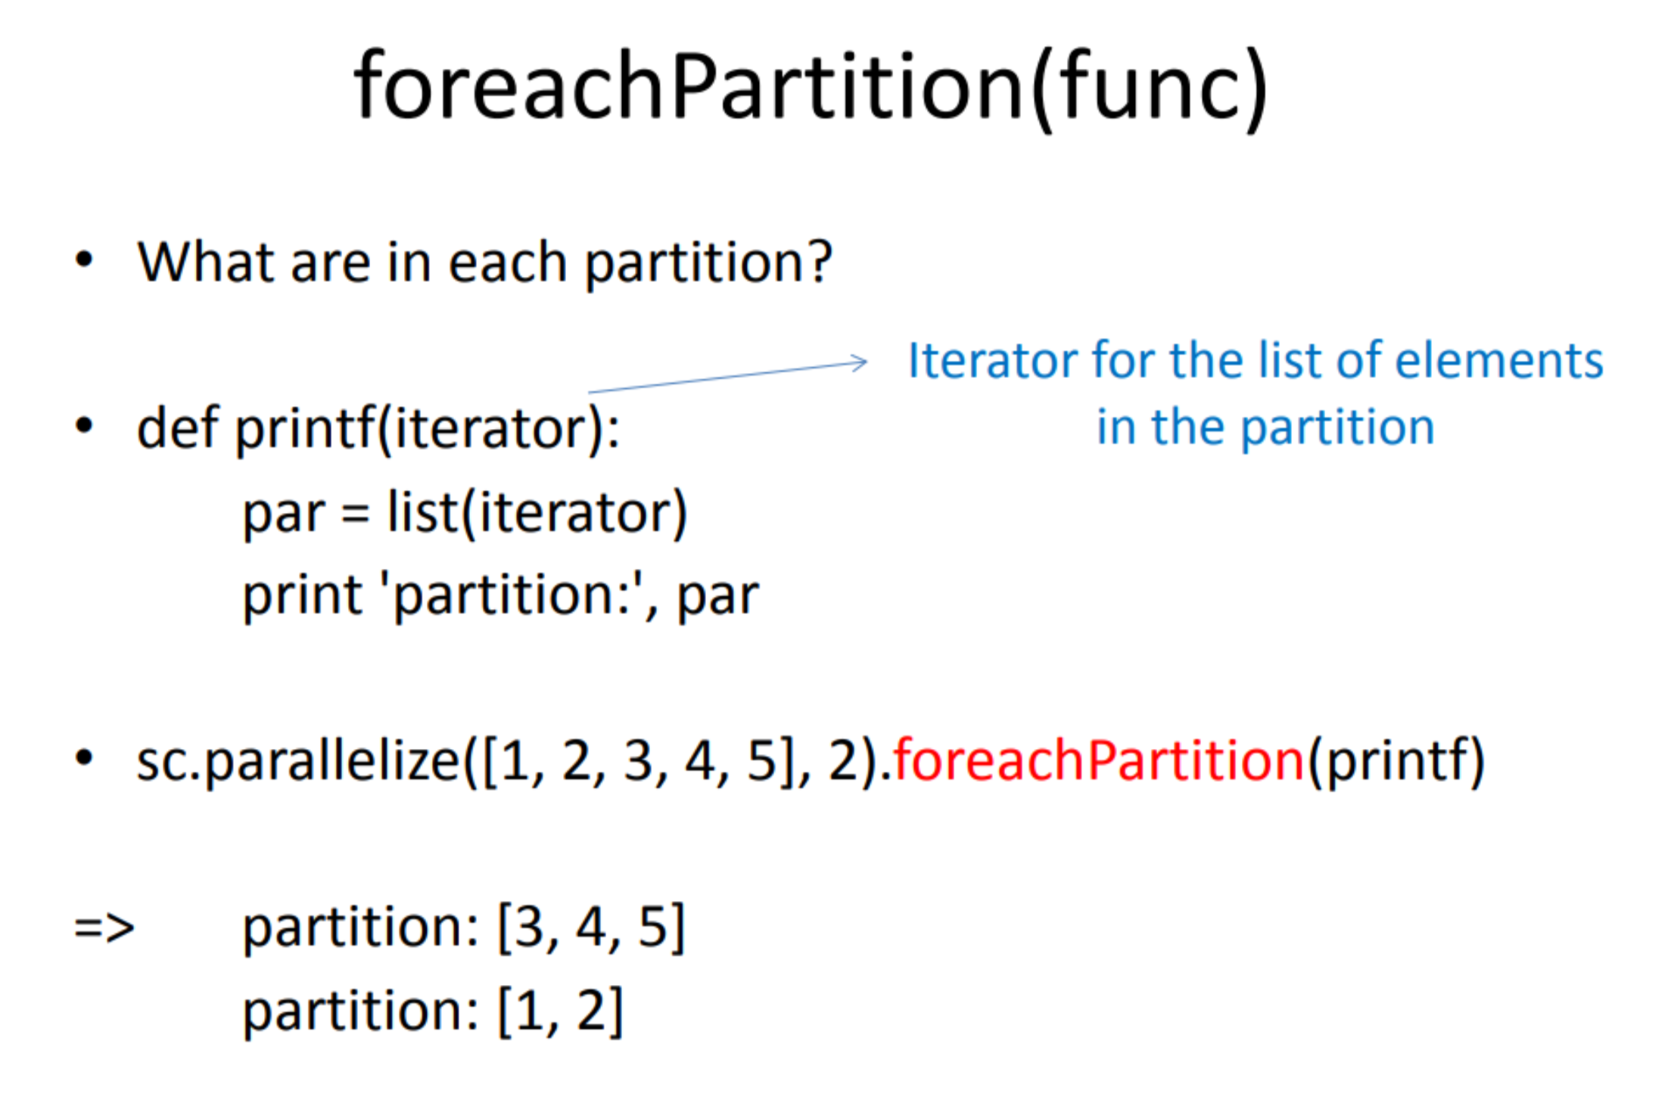

Slide 65
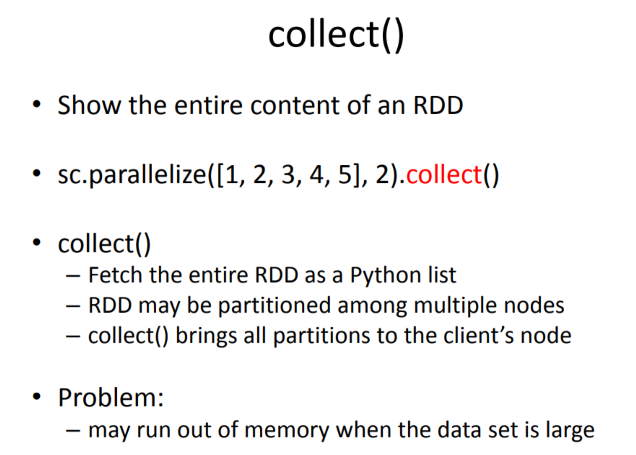

Slide 66
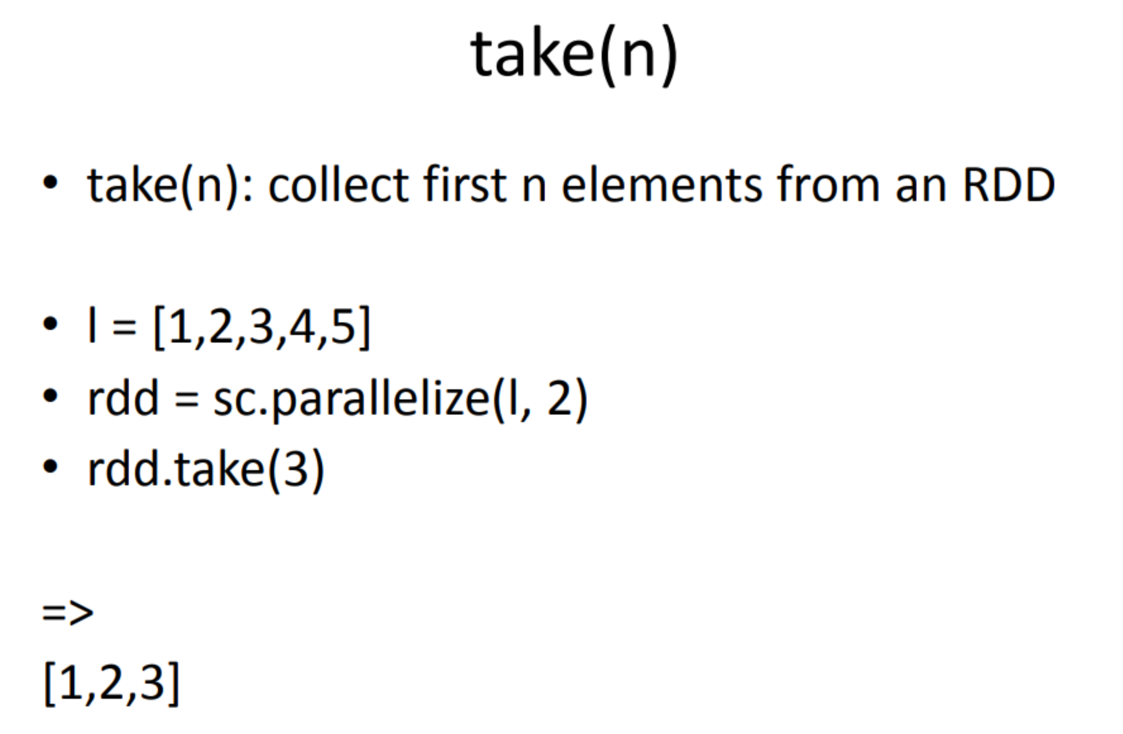

Slide 67
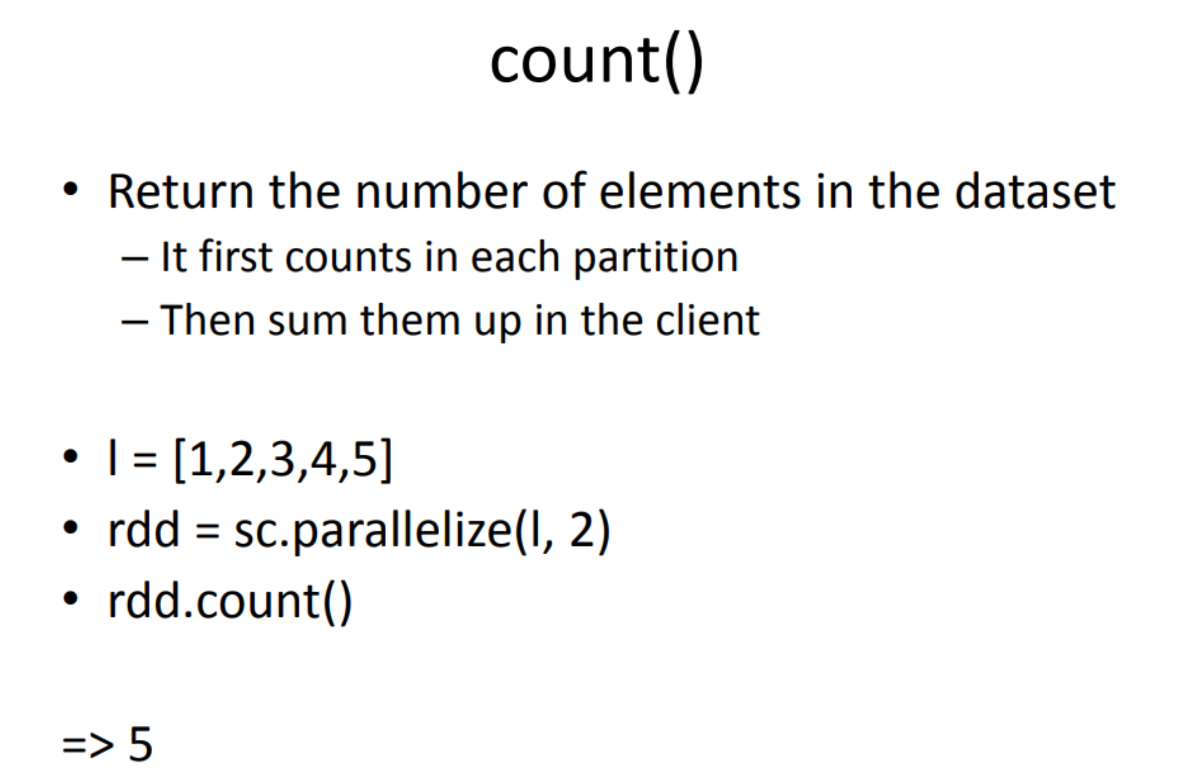

Slide 68
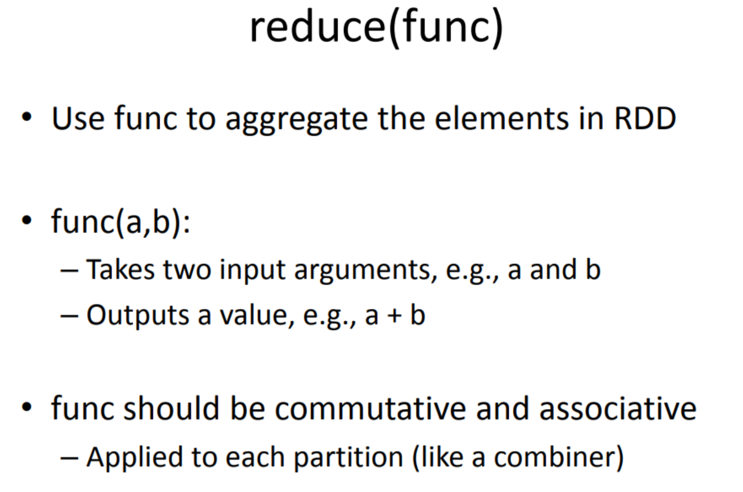

Slide 69
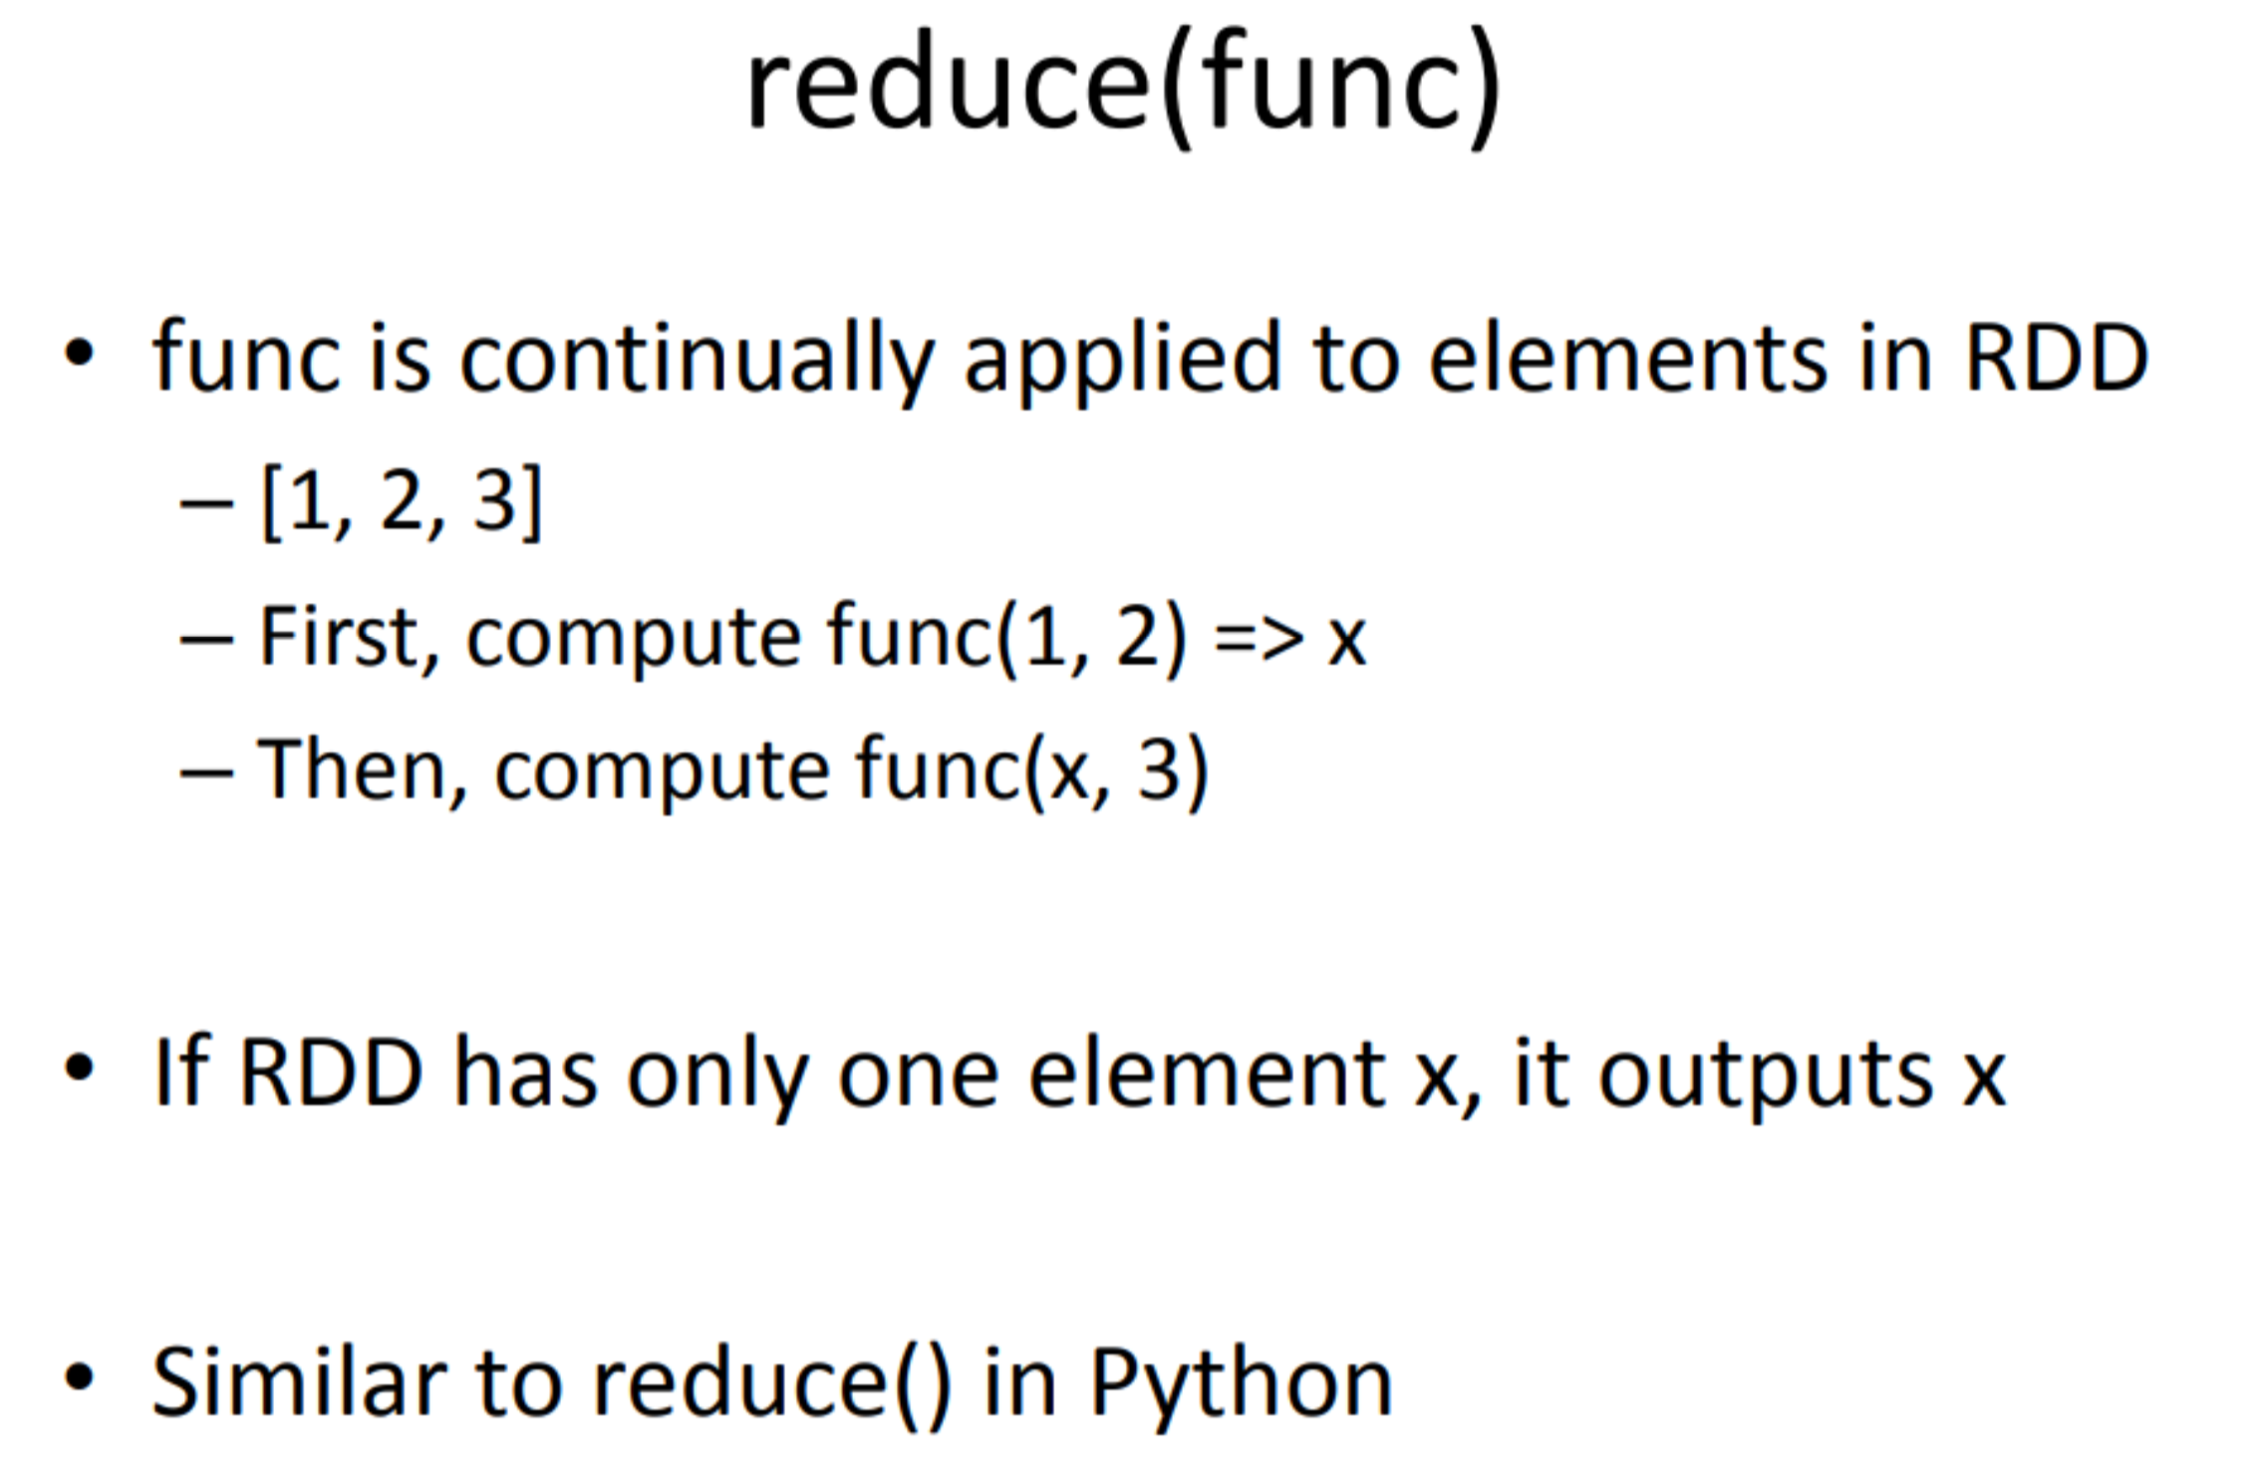

Slide 70
Exa mple: finding la rgest integers
• data = [S,4, 4, 1, 2, 3, 3, 1, 2, 5,4, S]
pdata = sc.parallelize( data)
pdata .reduce( lambda x,y: max(x,y))
=> 5

Slide 71
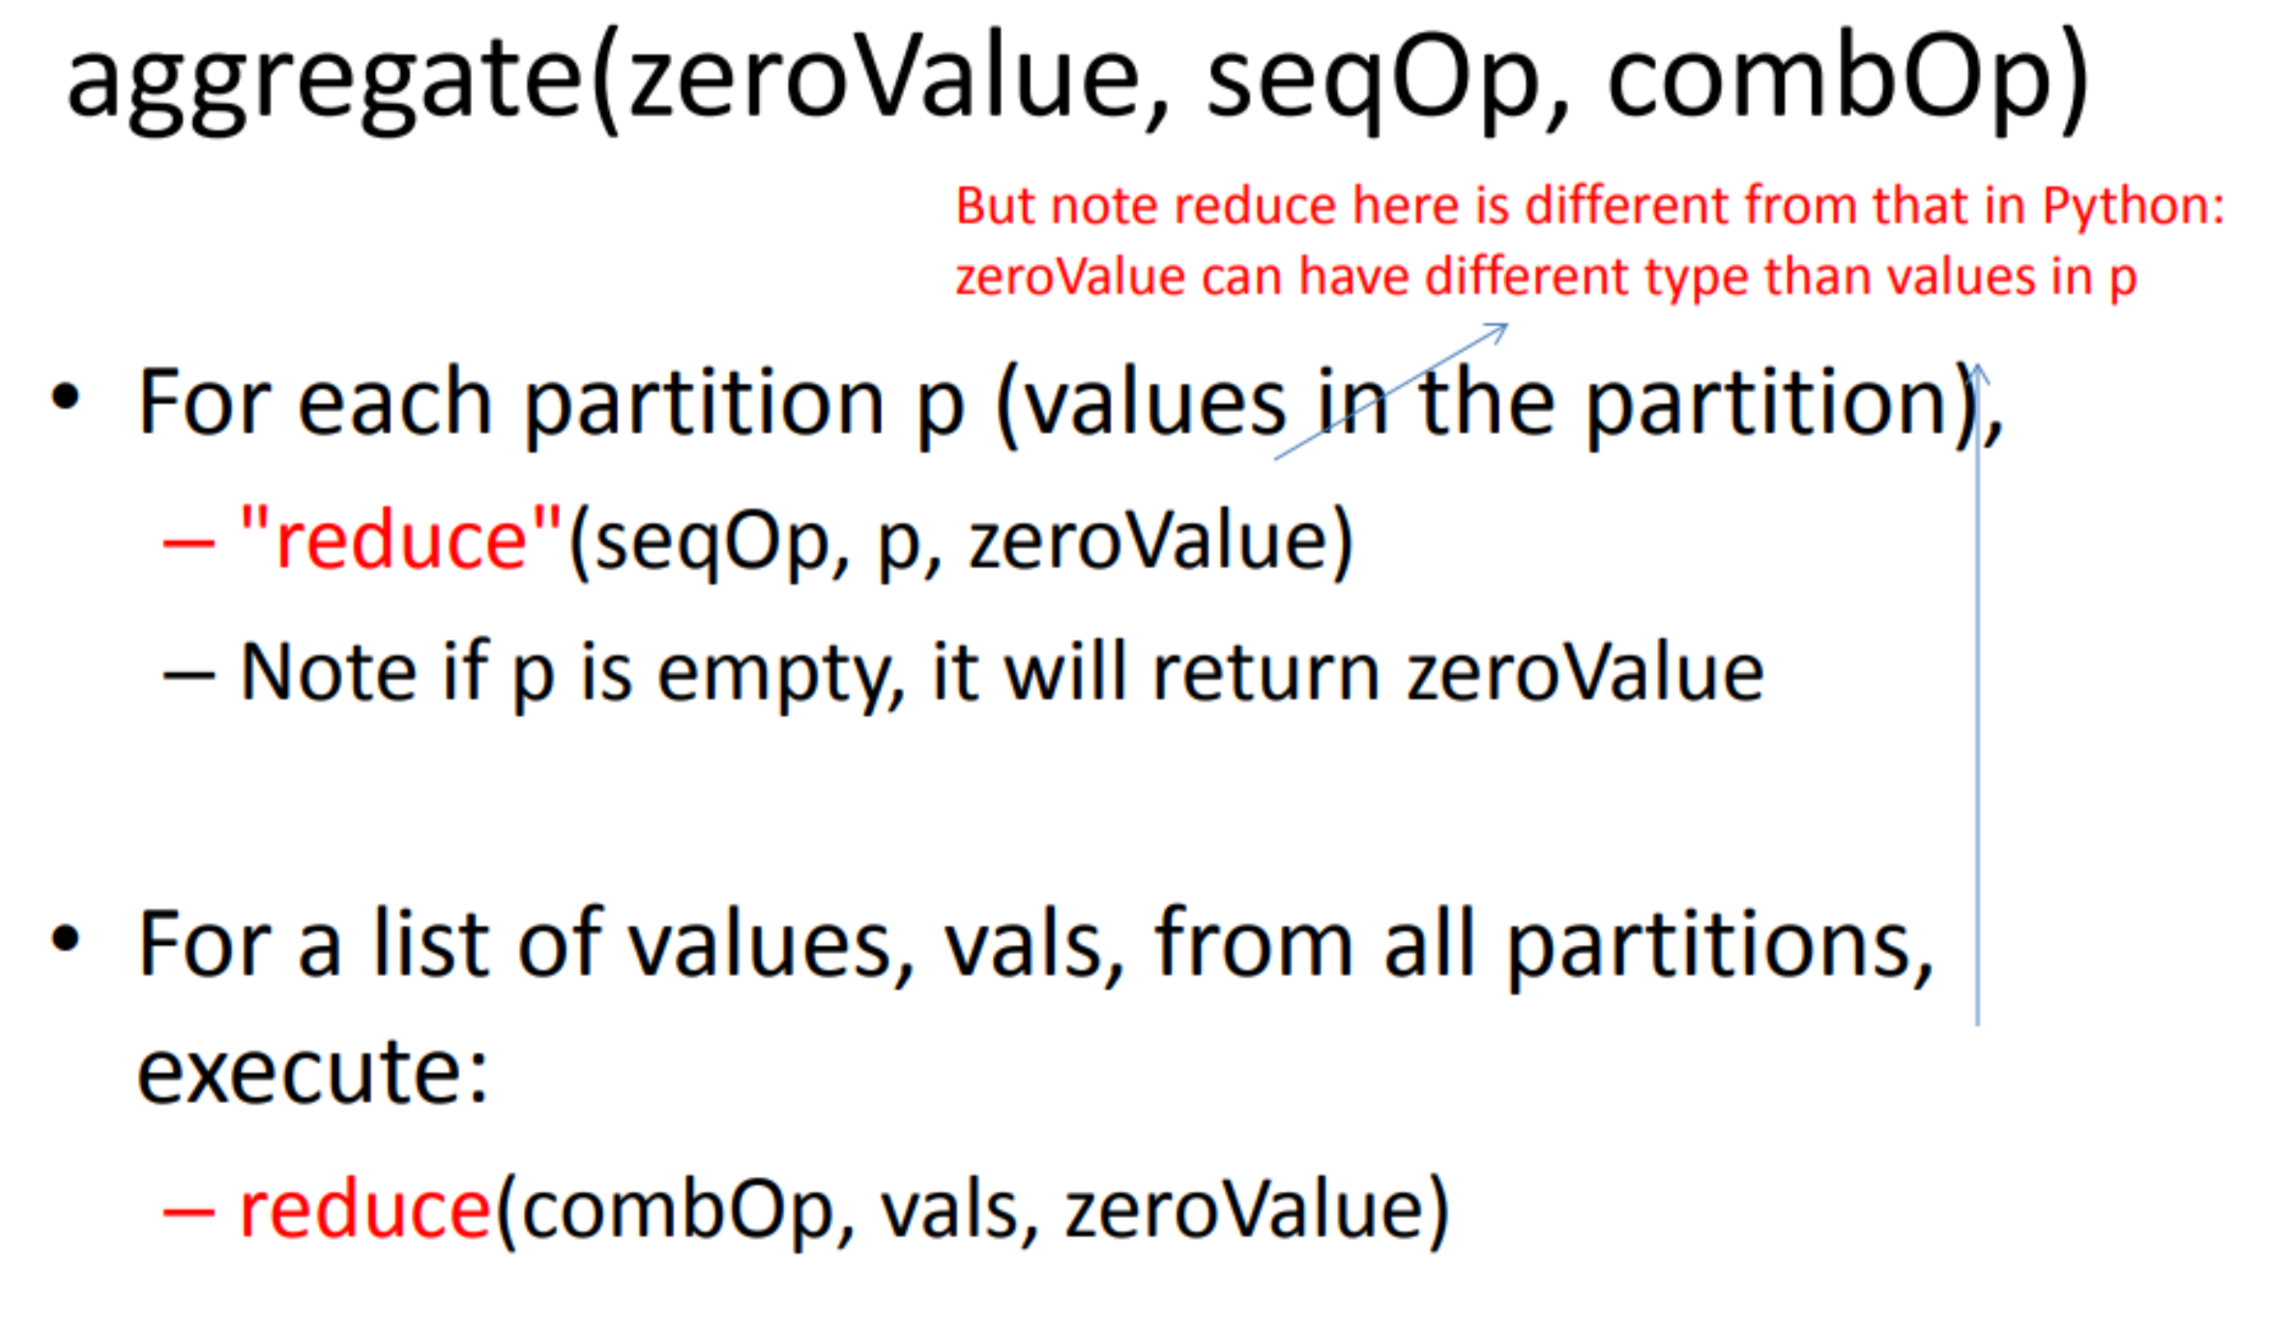

Slide 72
Exa mple
data = sc.parallelize( [1],2)
data.foreachPa rtition( printf)
- Pl: []
- P2: [1]
data.aggregate(1, add,add)
- Pl => [1] => after reduction => 1
- P2 => [1] + [1] = [1,1] => 2
- fina l: [1] + [1,2] => [1,1,2] => 4

Slide 73
Exa mple
data.aggregate(2, add, lambda U,v: U * v)
- Pl => 2
- P2 => 3
- FinaI: [2] + [2,3] => 2 * 2 * 3 = 12
(w here [2] is zeroVa lue,[2,3] is the list of va lues from partitions)

Slide 74
Common Transformations
map(func)
mapValues(func)
filter(func)
flatMap(func)
reduceByKey(func, [numTasks])
groupByKey([numTasks])
sortByKey([asc], [numTasks])
distinct([numTasks])
mapPartitions(func)

Slide 75
map(func)
map(func): Apply a function func to each element in input RDD
- func returns a va lue (could be a list)
Output the new RDD conta ining the transformed va lues produced by func

Slide 76
Exa mple
lines = sc.textFile("hello.txt ")
lineSplit = lines.map(lambda s: s.split())
=> [['hello','world' ], ['hello', 'this', 'world' ]]
linelengths = lines.map(lambda s: len(s))
=> [11, 16]

Slide 77
ma pPartitions(fu nc)
Apply transformati on to a partition
input to func is an iterator (over the elements in the partition)
func must return an itera ble (a list or use yield to return a generator)
Different from map(func)
func in map(func) applies to an element

Slide 78
f l atMap(func)
flat Map(func):
similar to map
But func here must return a list (or generator) of elements
- & flatMap merges these lists into a single list
lines.flatMa p(lambda x: x.split())
=>rdd: ['hello', 'world','hello','this','world' ]

Slide 79
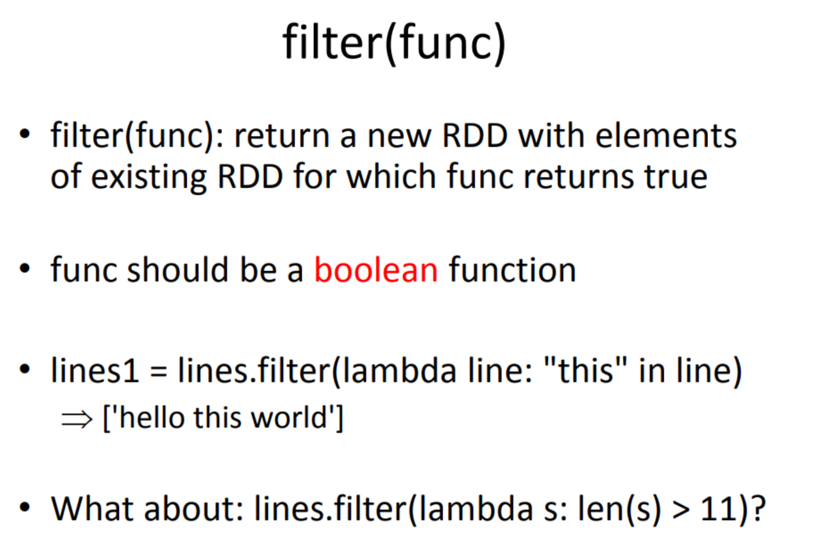

Slide 80
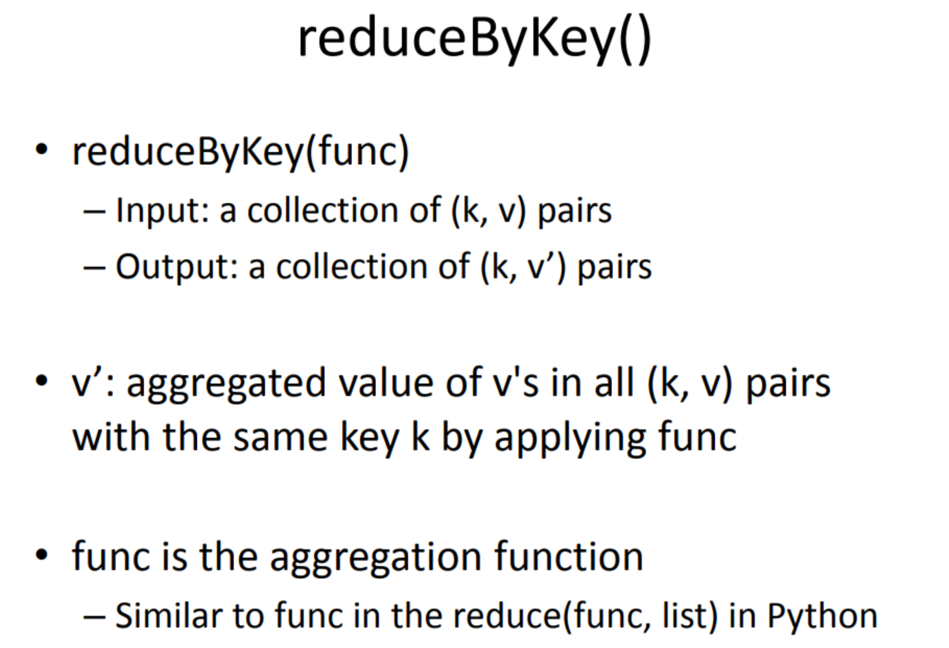

Slide 81


Slide 82


Slide 83

Laziness Example

Slide 84

Laziness Example

